Slide 1
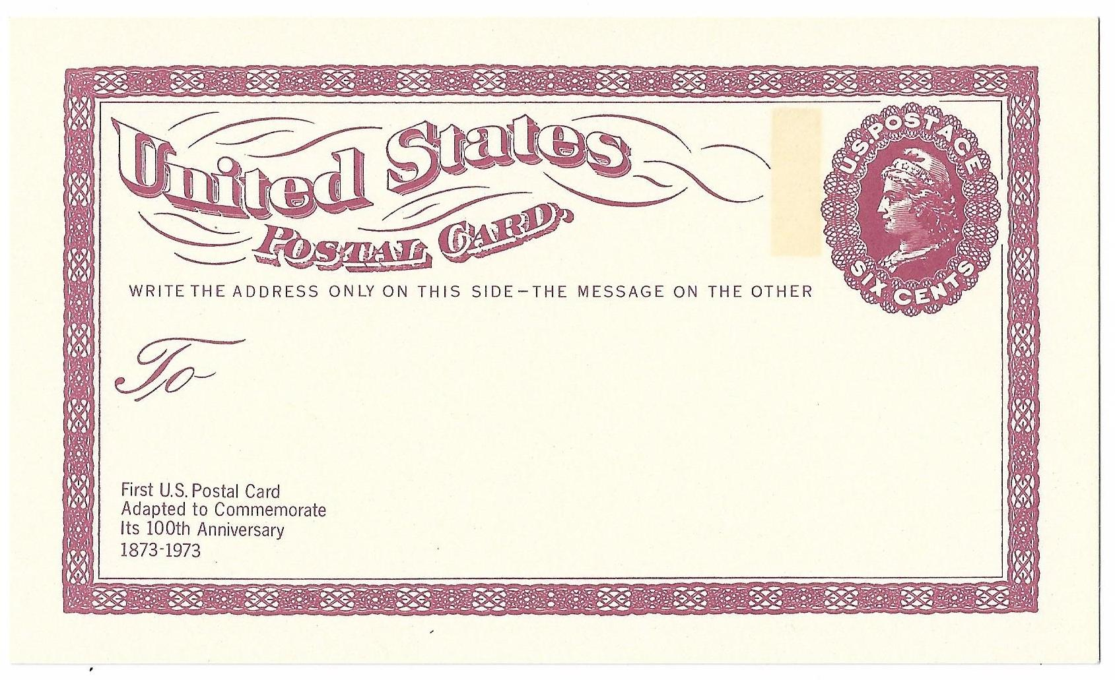
Centenary of the U.S. Postal Card

Slide 2
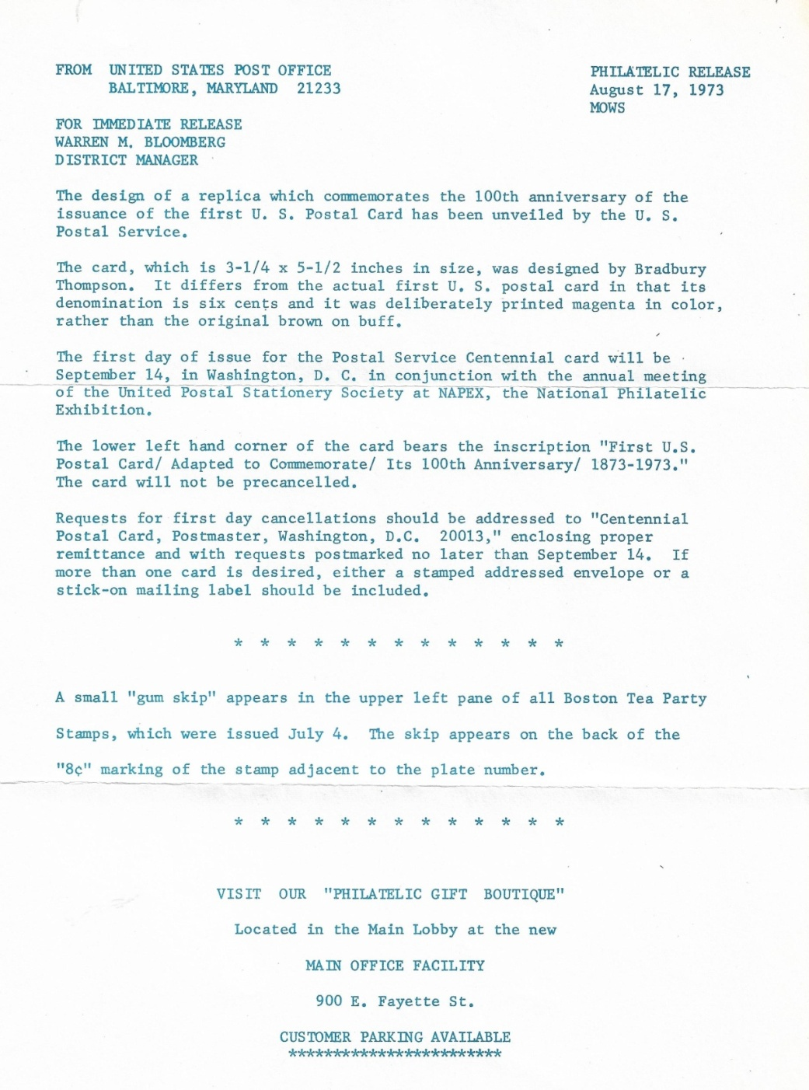
USPS Press Release

Slide 3
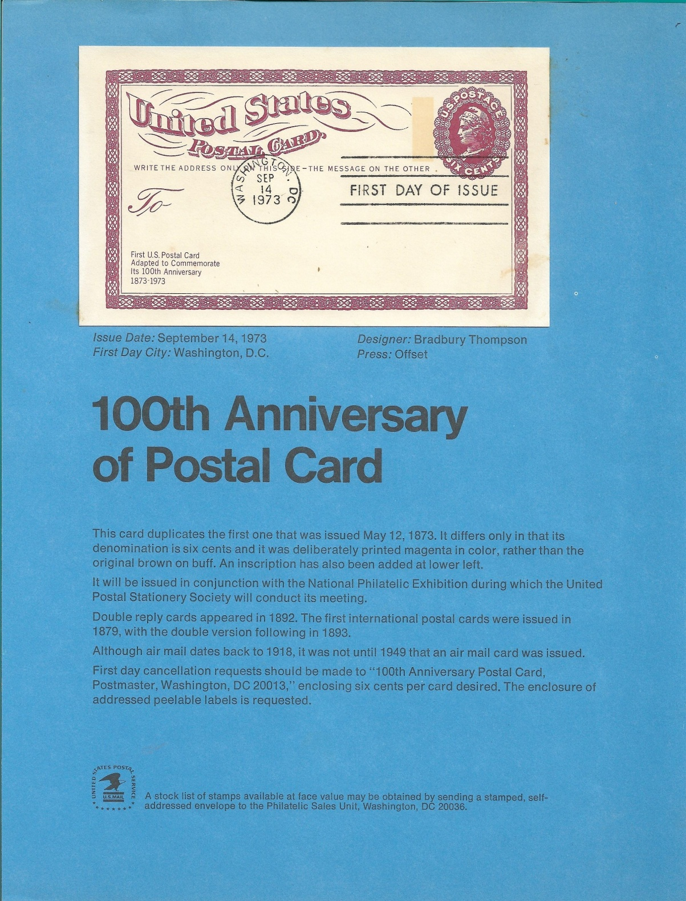
Commemorative
Panel

Slide 4
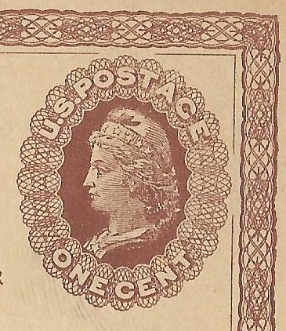
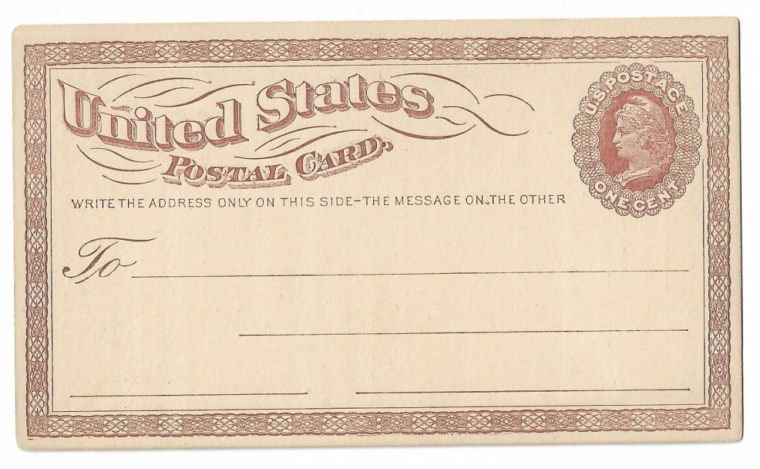
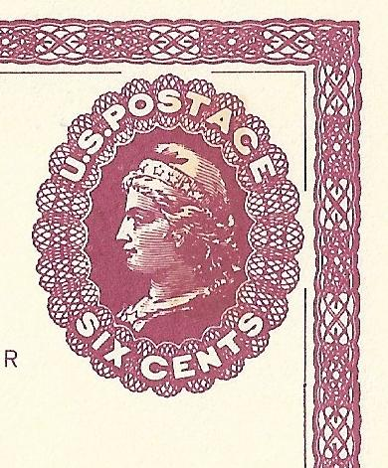

Reproduction of Actual Subject Plate 14

Slide 5
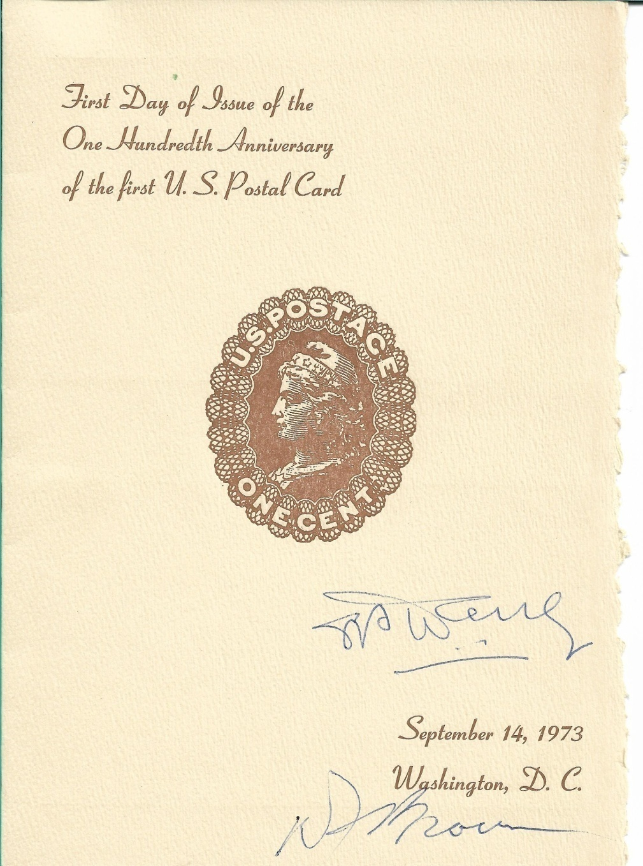
First Day Ceremony Program
Signed by
Darrell Brown, Assistant PM and Robert Haring President AAMS

Slide 6
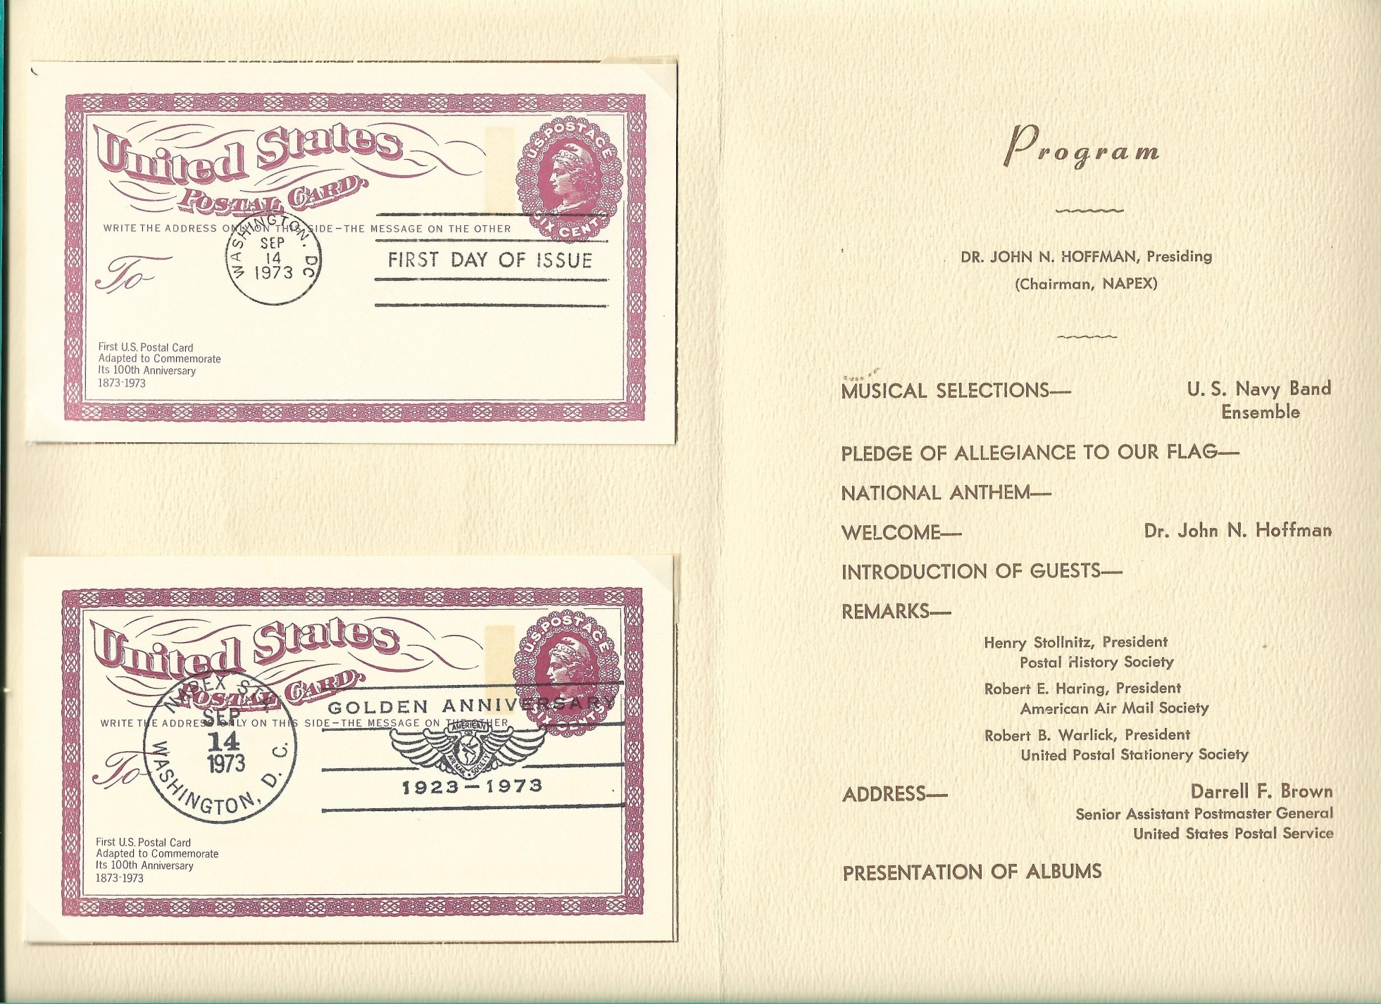
Inside Cover

Slide 7
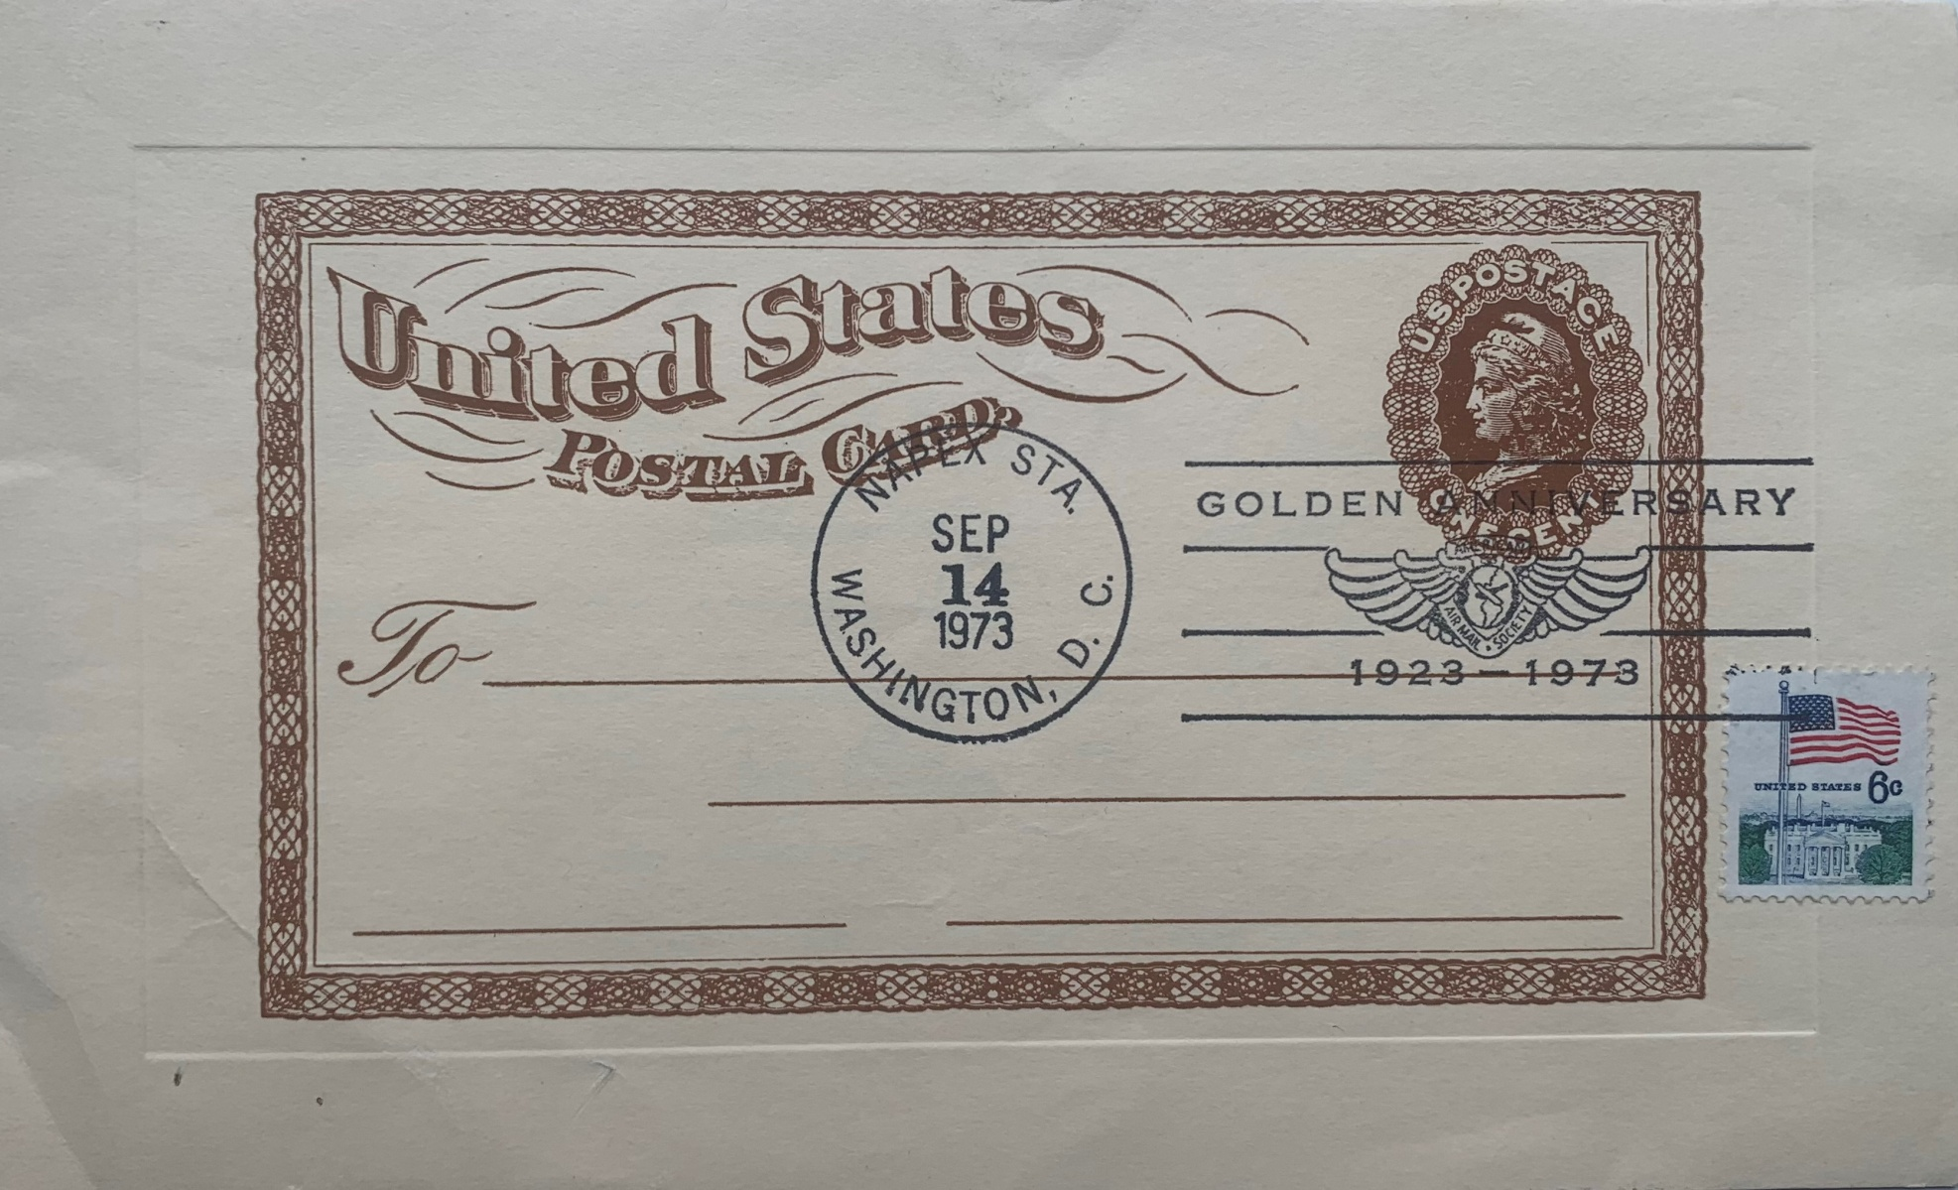
NAPEX Souvenir Sheet

Slide 8
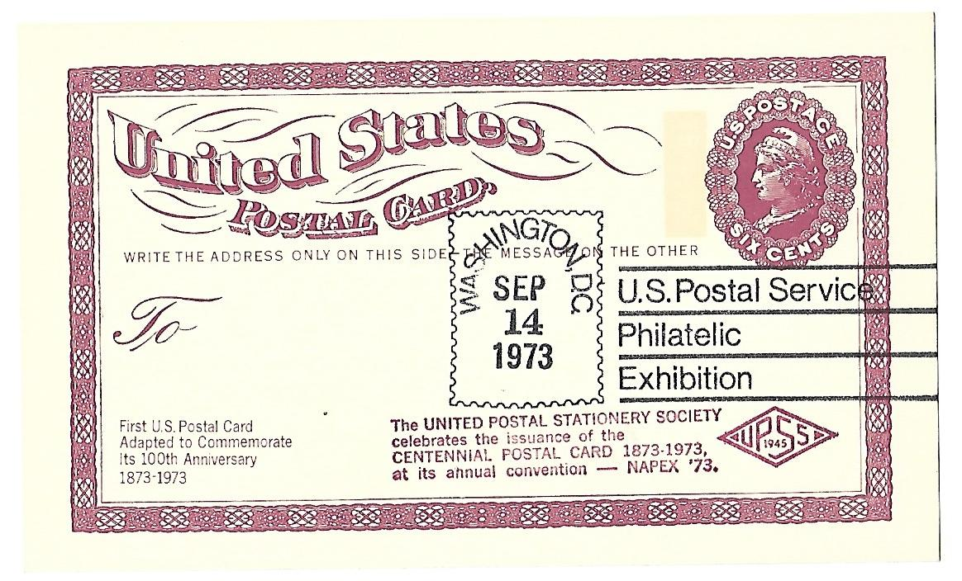
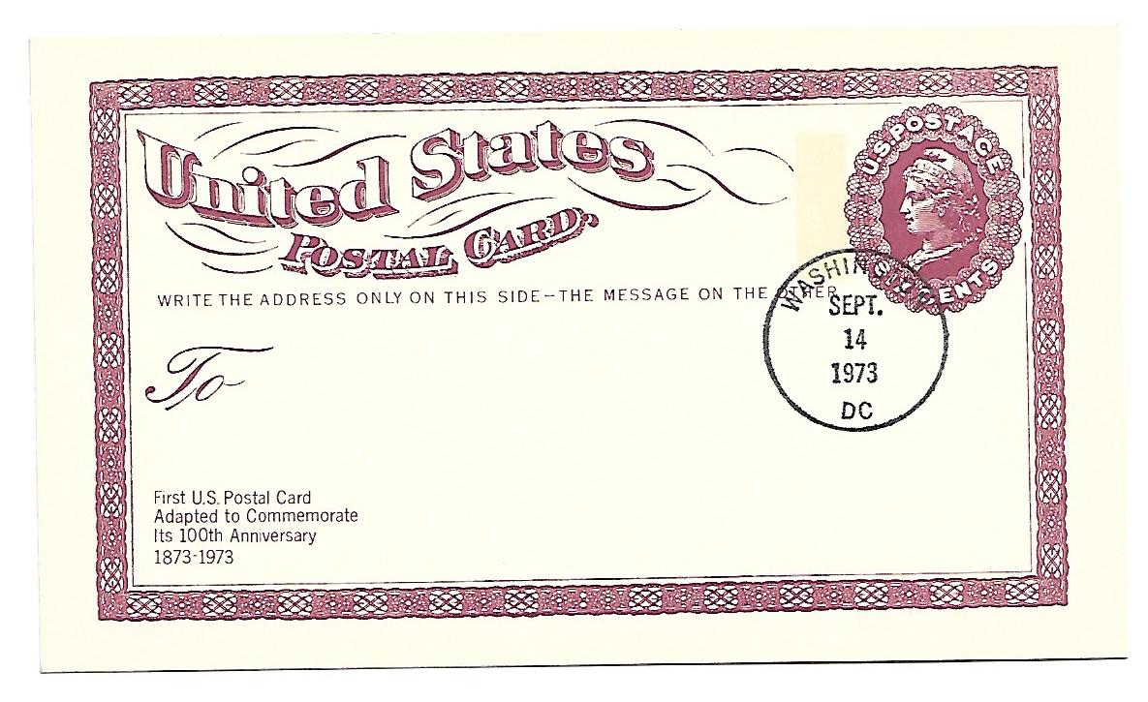
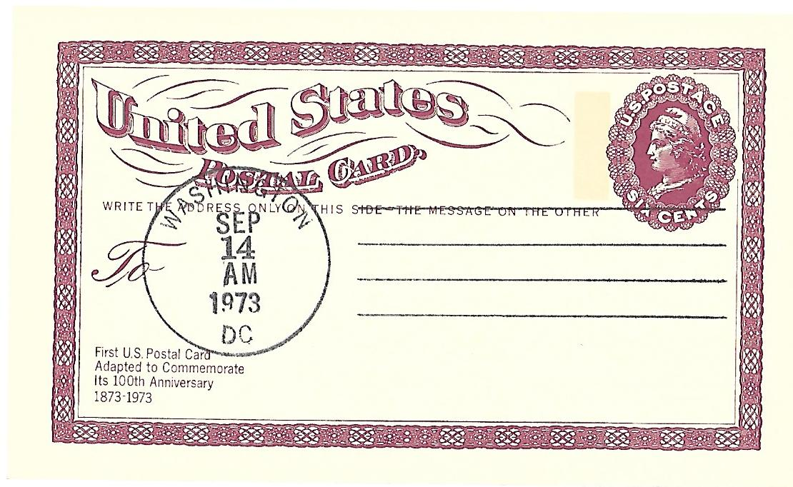
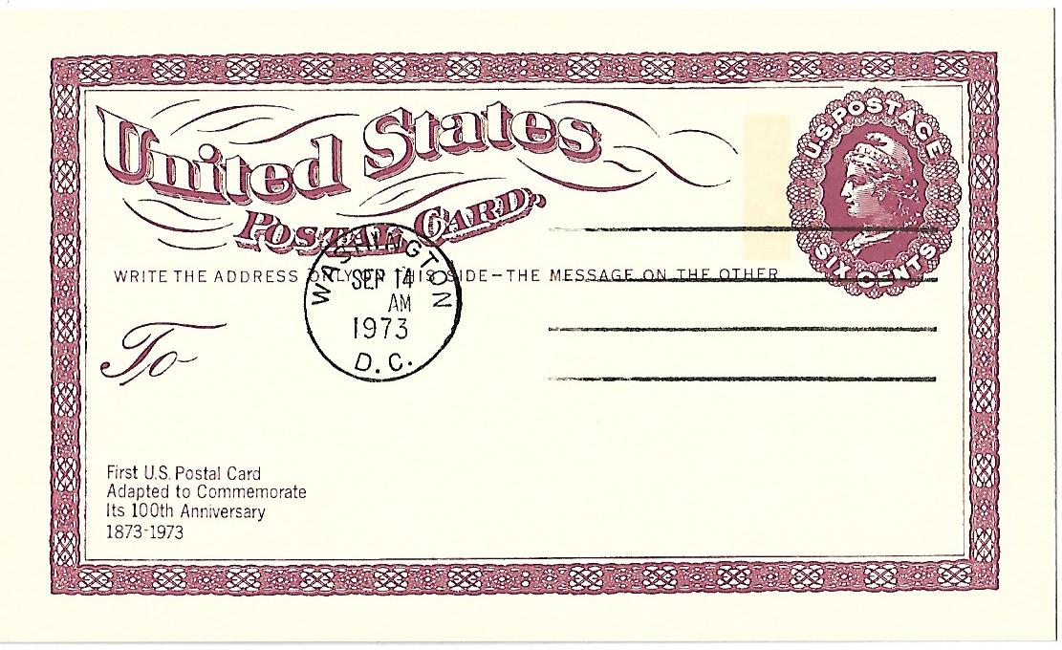
FDOI Washington DC Hand Cancels

Slide 9
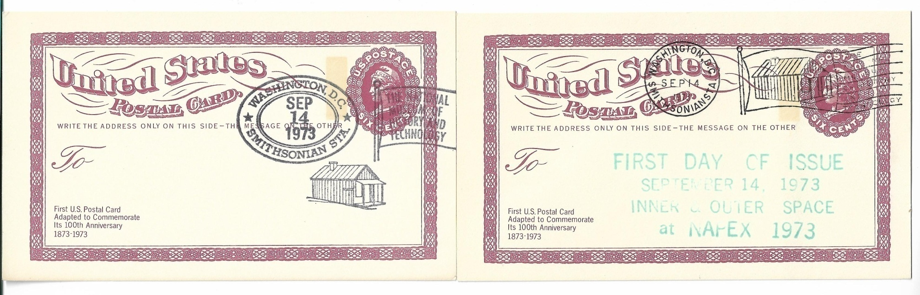
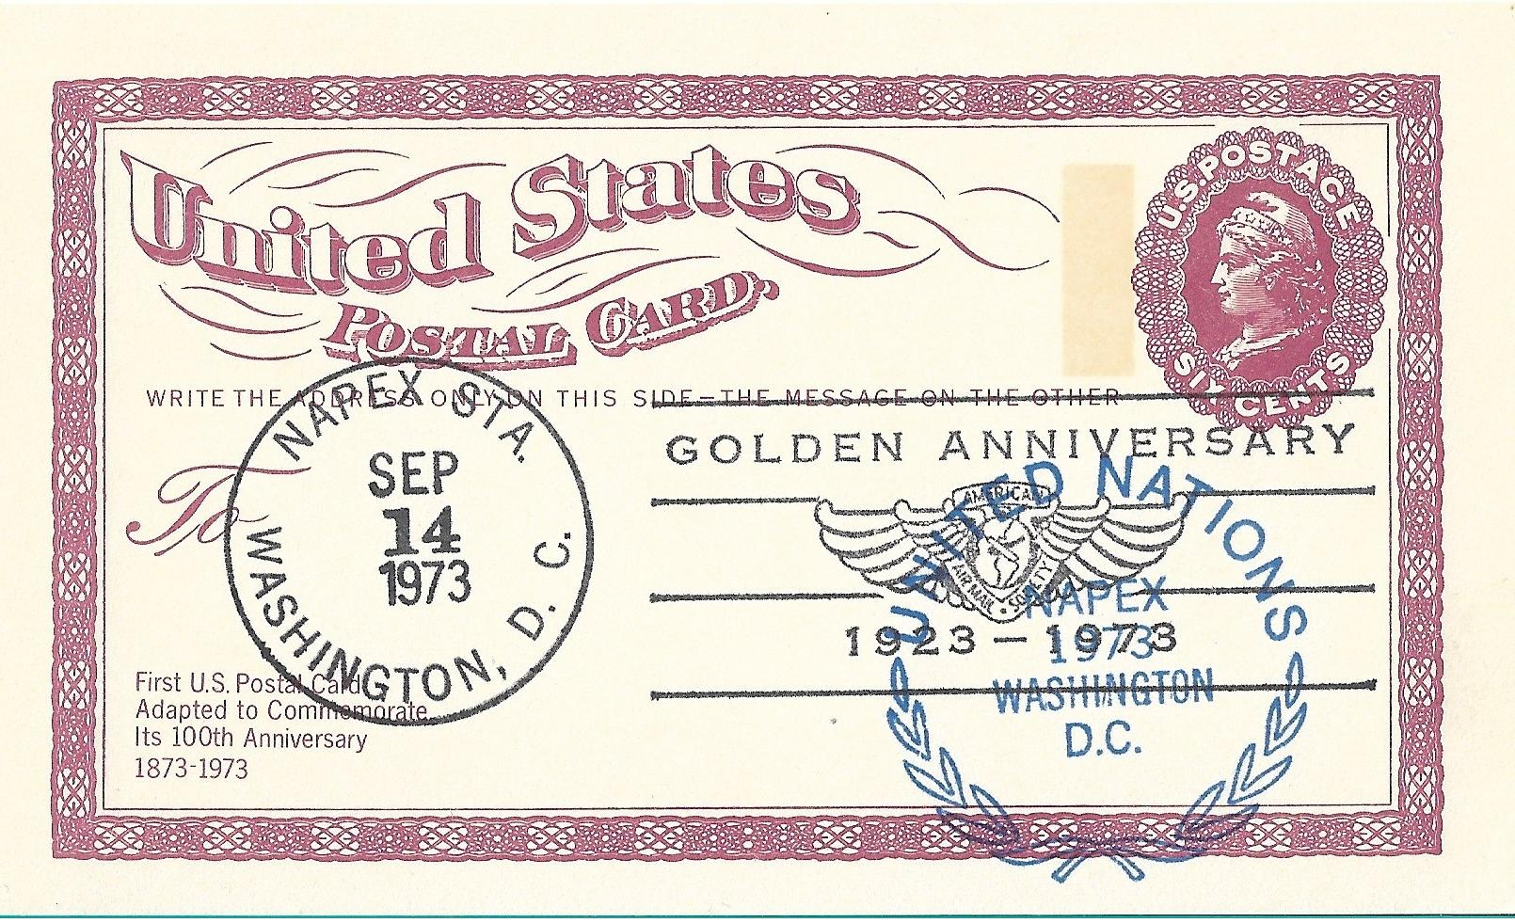
FDOI Smithsonian Station
United Nations
Show Cancel

Slide 10
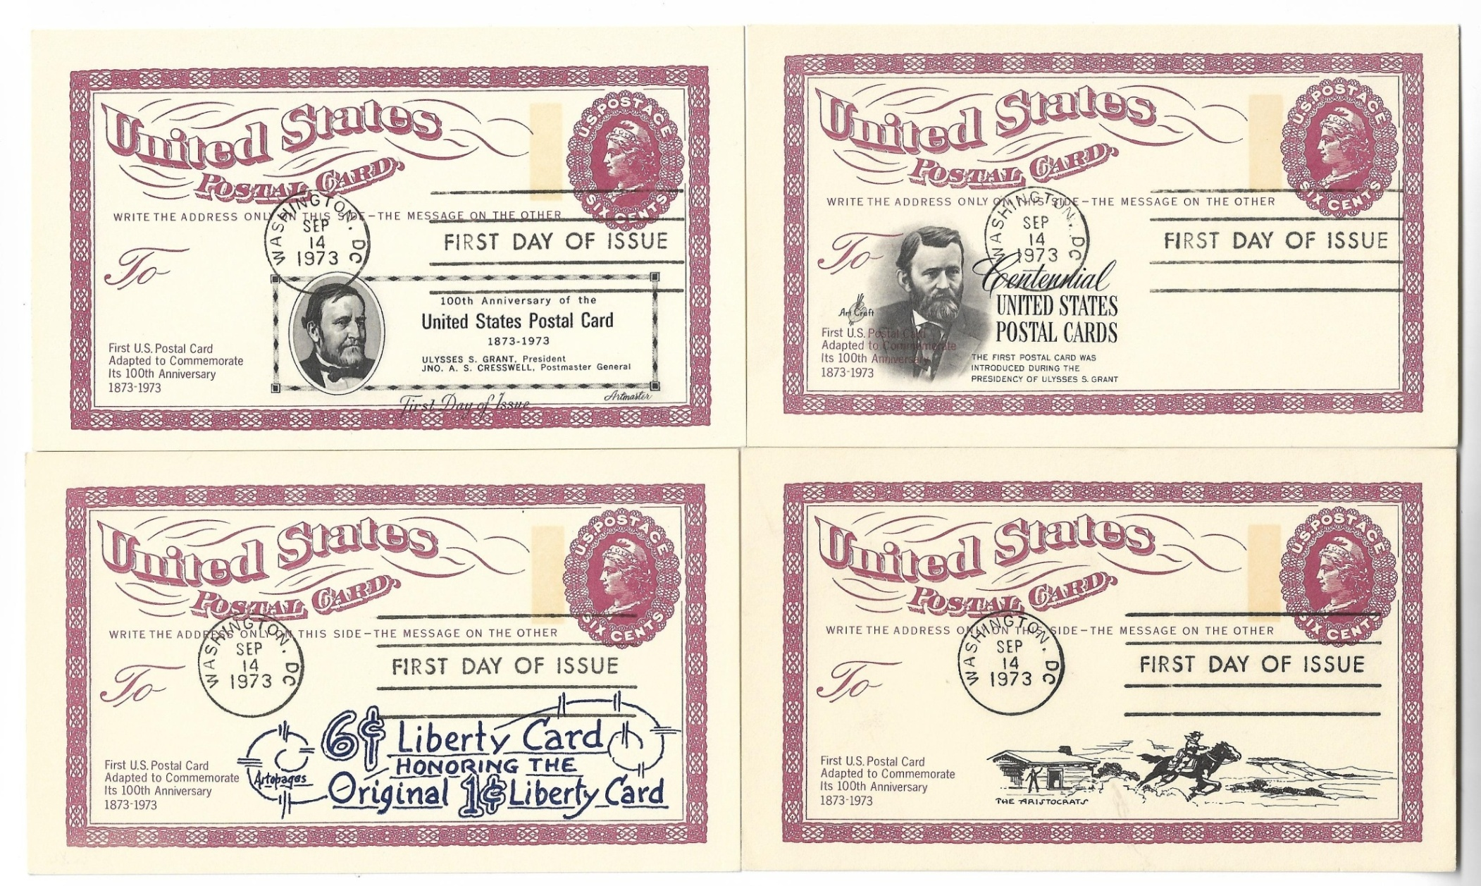
Commercial First Day Cachets
Artmaster
Art Craft
Artopages
Aristocrats

Slide 11
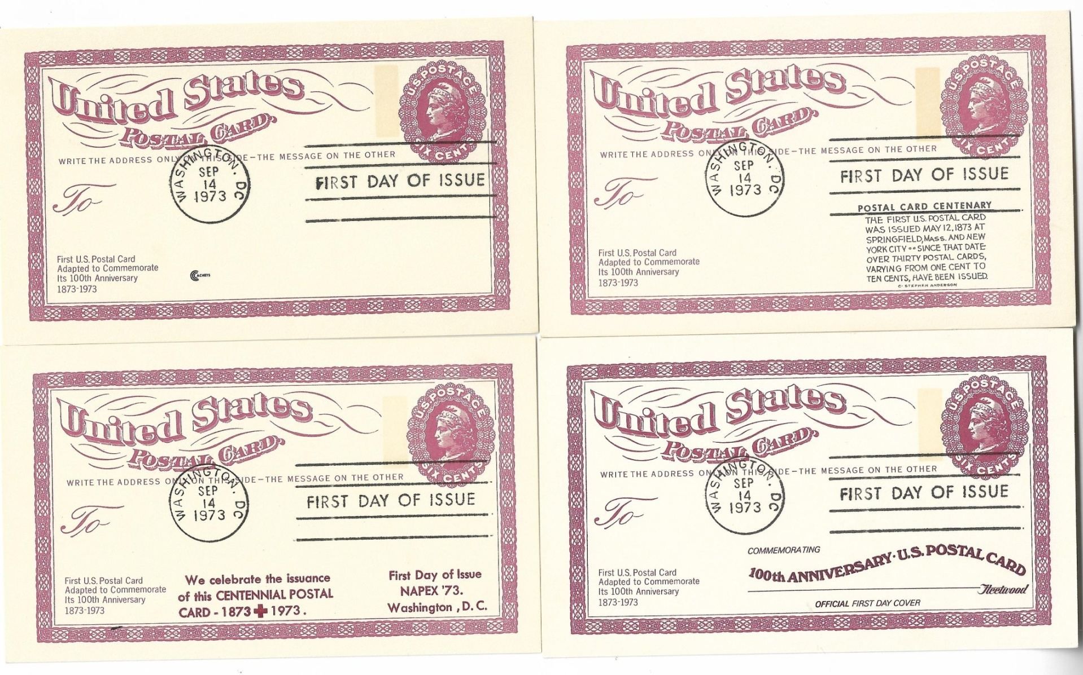
Commercial First Day Cachets
Cachets
Anderson
Blair Law
Fleetwood

Slide 12
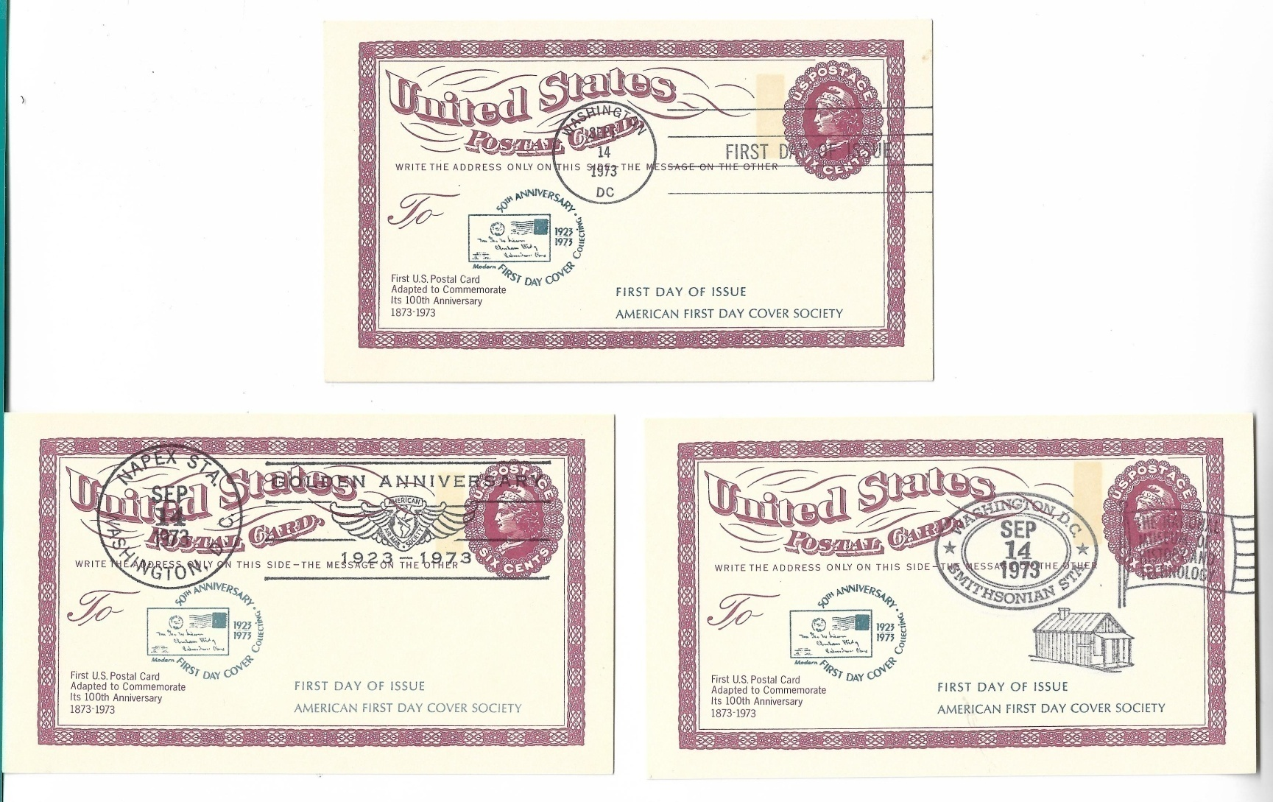
American First Day Cover Society

Slide 13
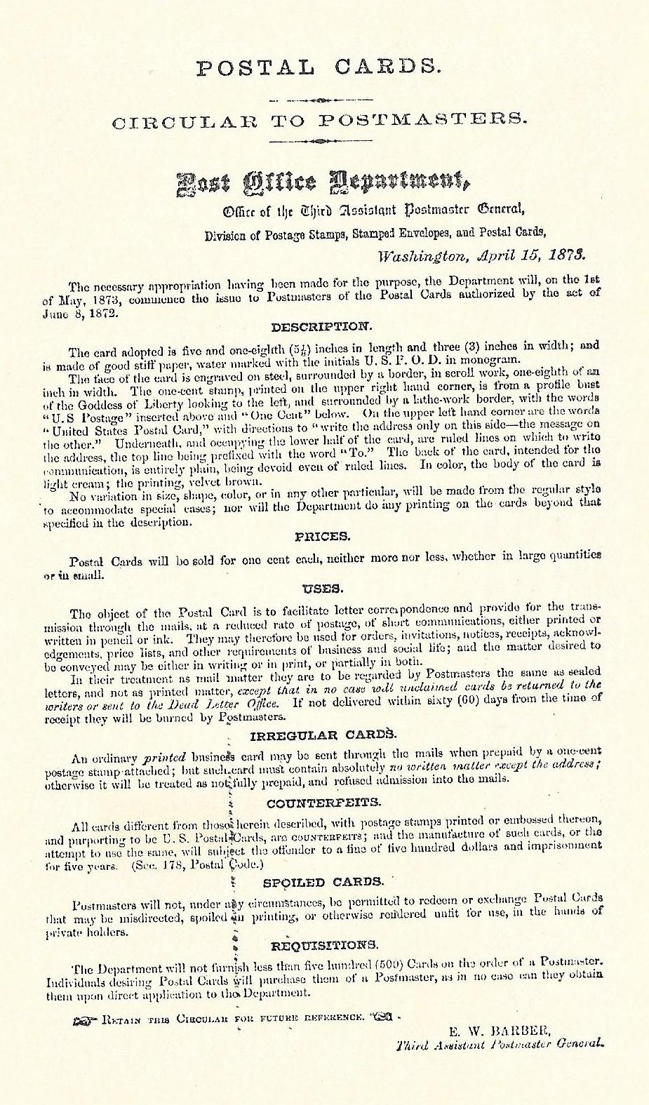

UPSS Cachet
United Postal Stationery Society
Back

Slide 14
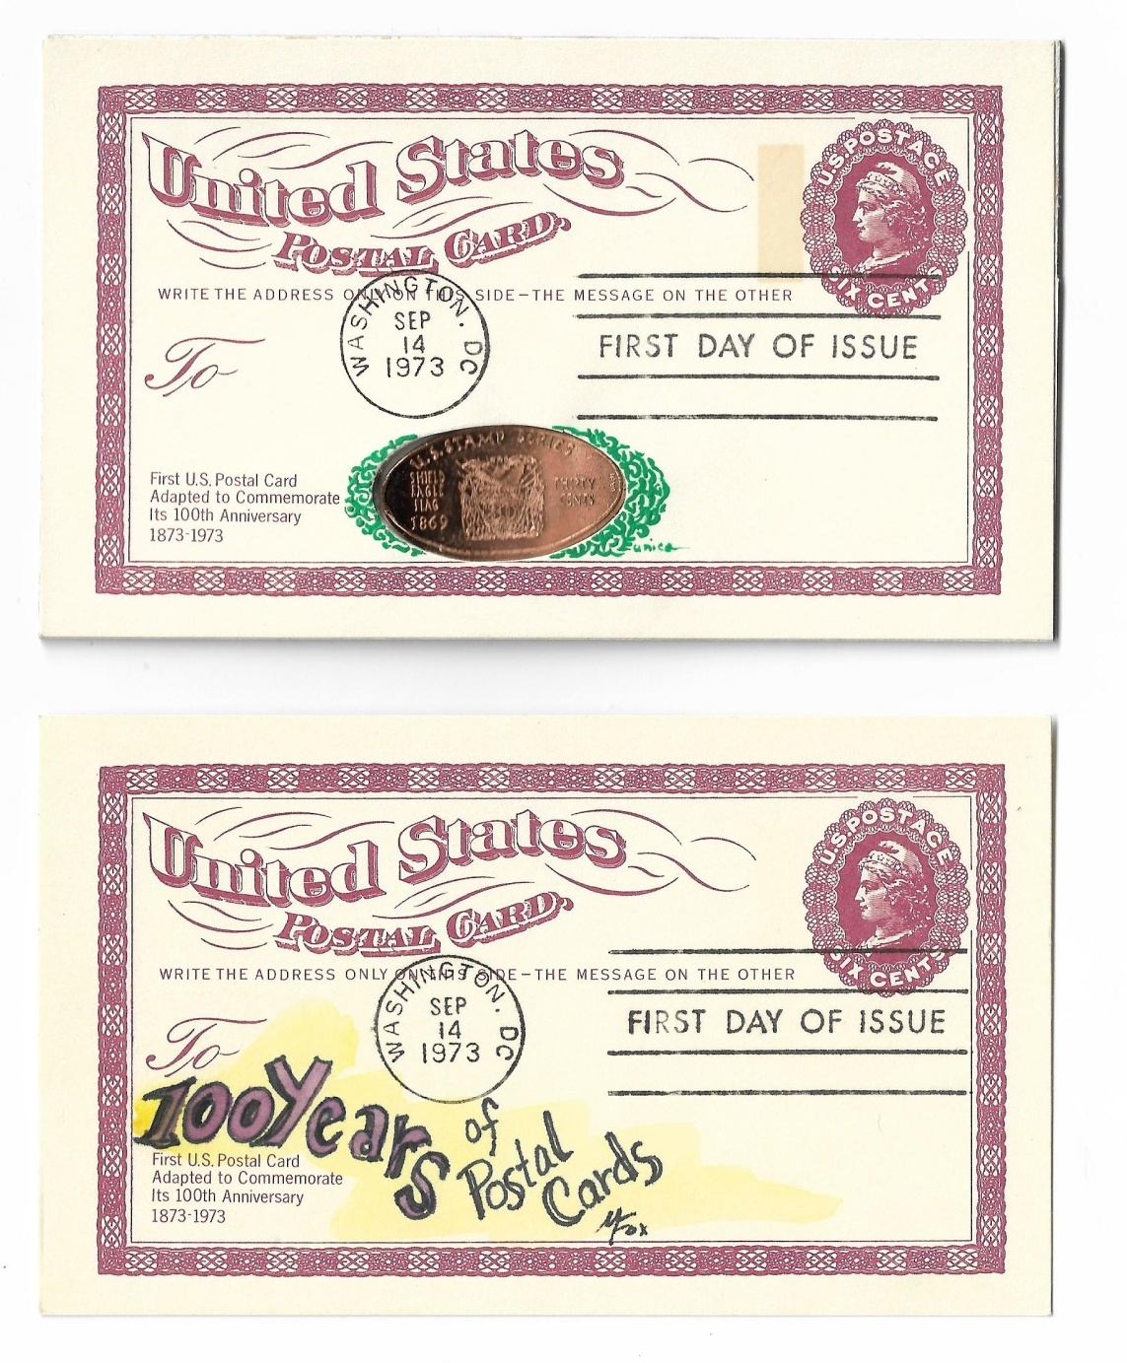
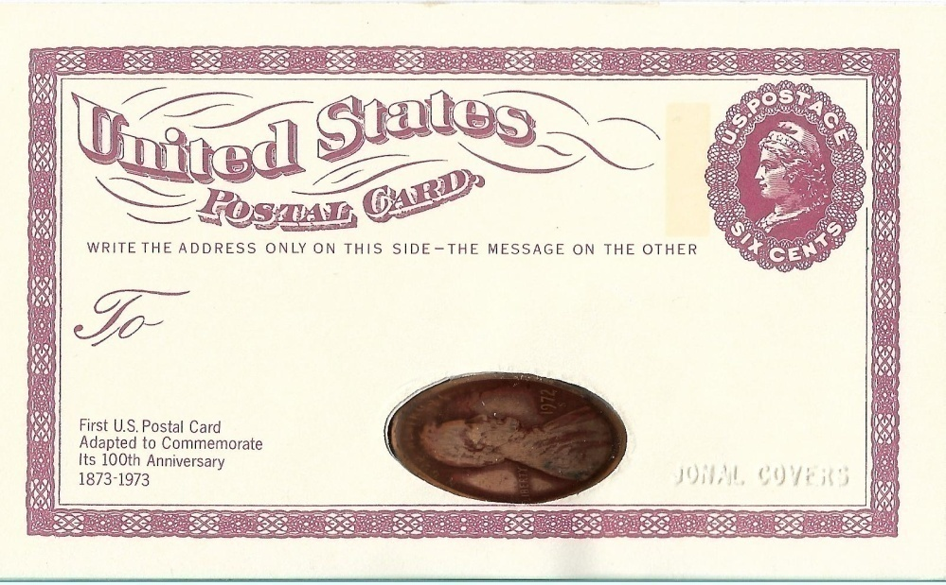
Hand Made Cachets
TOP: Jonal Covers 50 Produced
Bottom : Melissa Fox Cachet 1 of 1
( Tag Bar Missing)

Slide 15
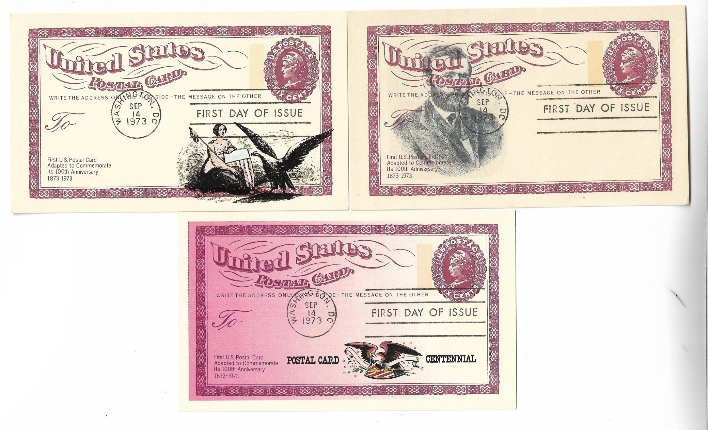
Internet Add On Cachets
Thermo Printed
Ink Jet Printed
Scanned card, photo shopped cachet and printed on a desk top

Slide 16
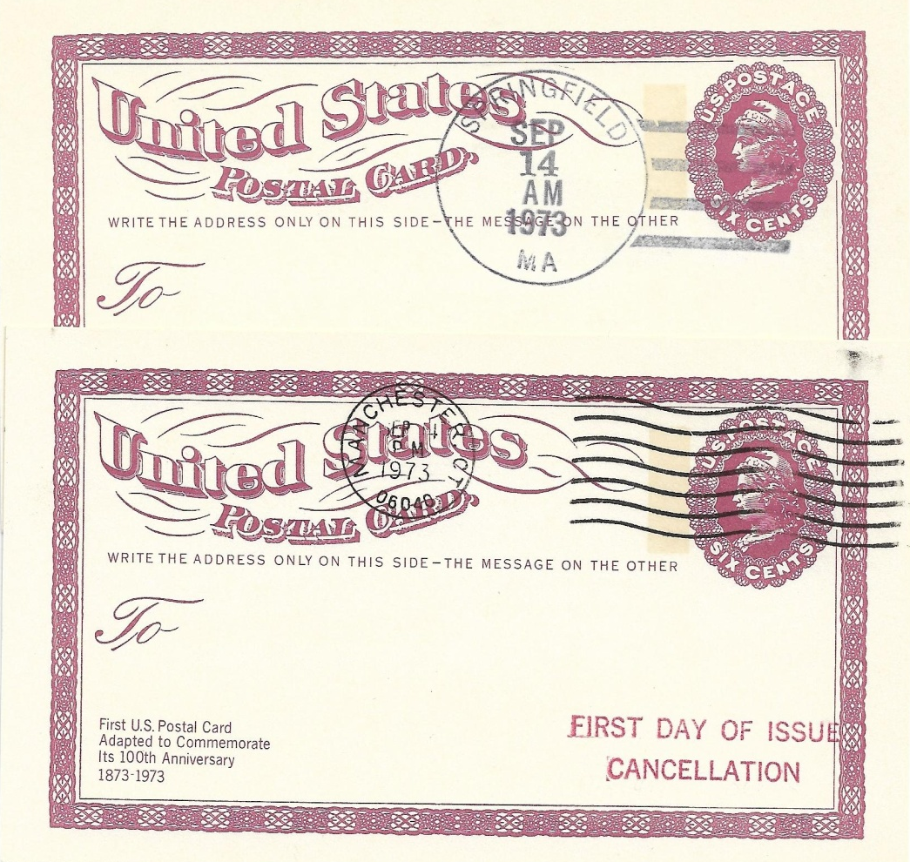
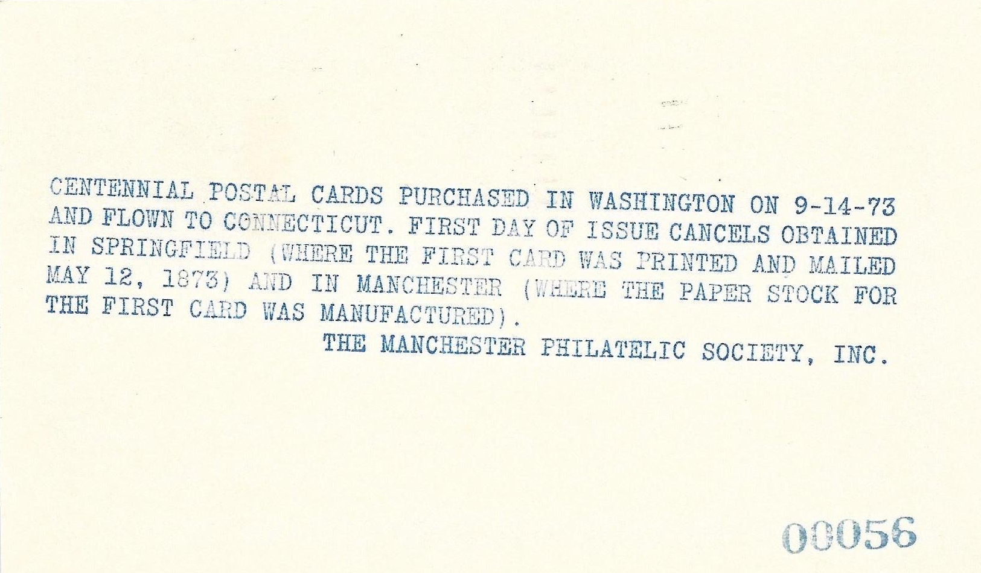
Other First Day Cities
Springfield , MA
Manchester, CT

Slide 17
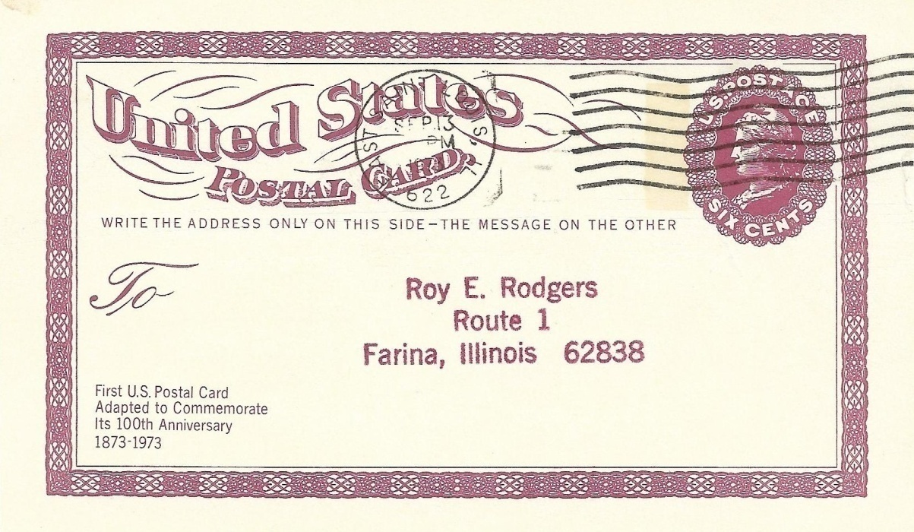
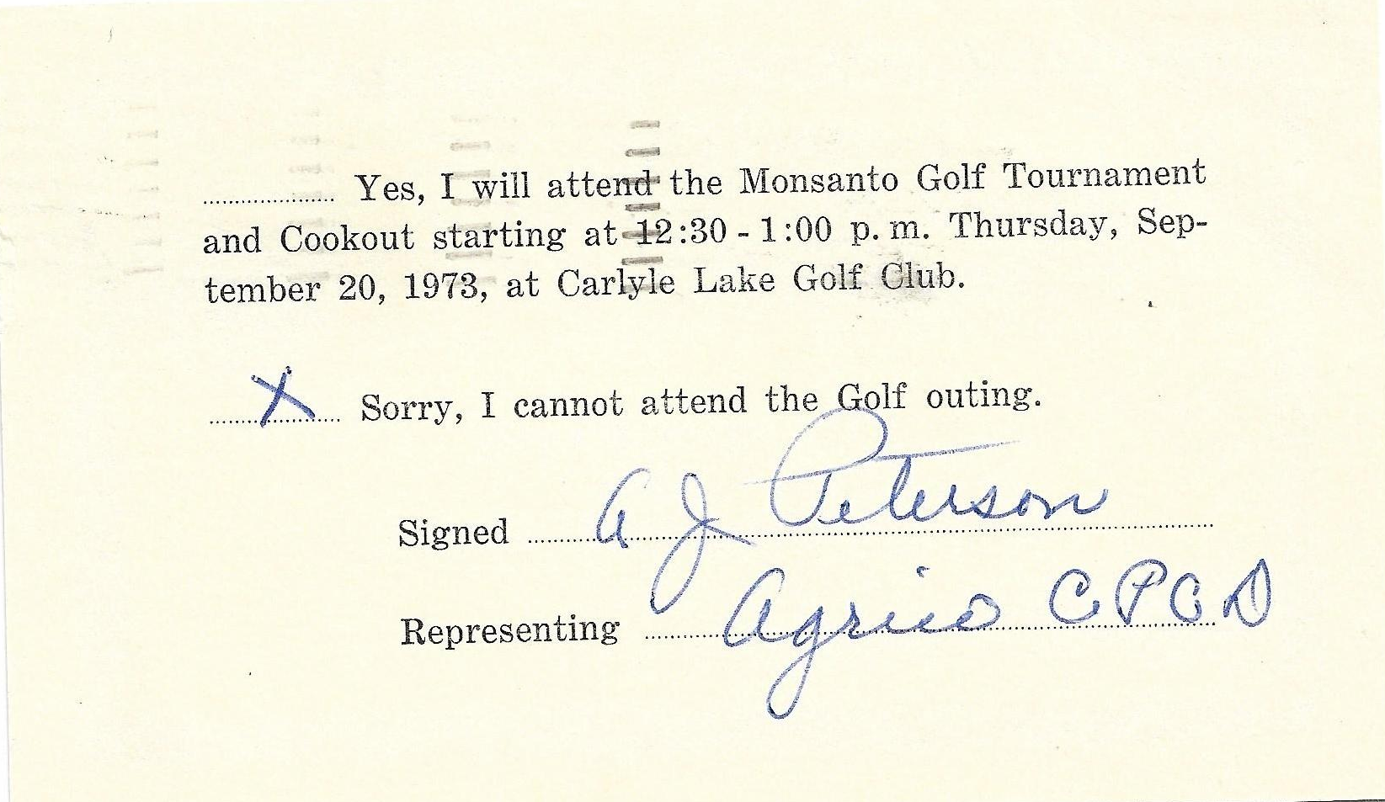
Pre First Day Cancels
East St. Louis, Illinois September 13, 1973.

Slide 18
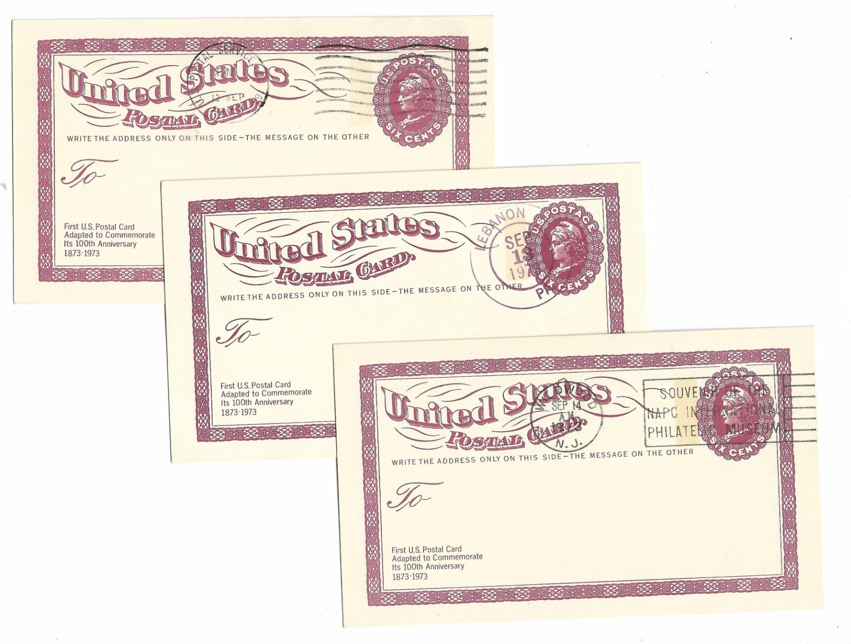
Hand Back Pre First Day Cancels
US POSTAL SERVICE SEPT 12 1973
LEBANON,PA SEPT 13 1973
WINDWOOD N.J. SEP 14 1973
SOUVENIR OF THE NAPC INTERNATIONAL PHILATELIC MUSEUM

Slide 19
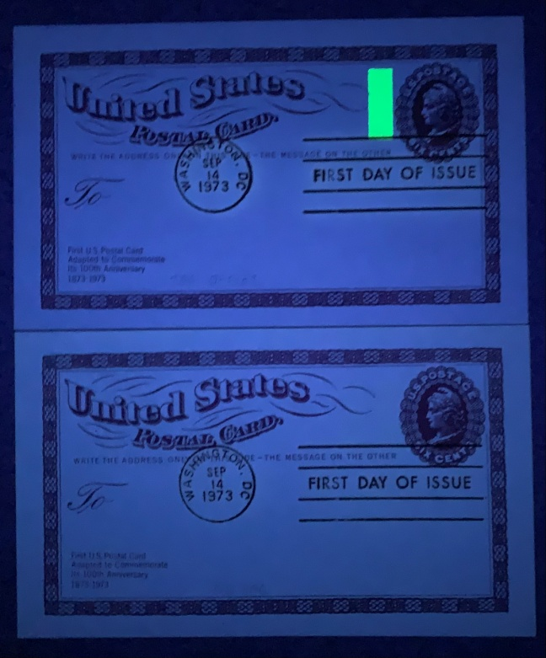
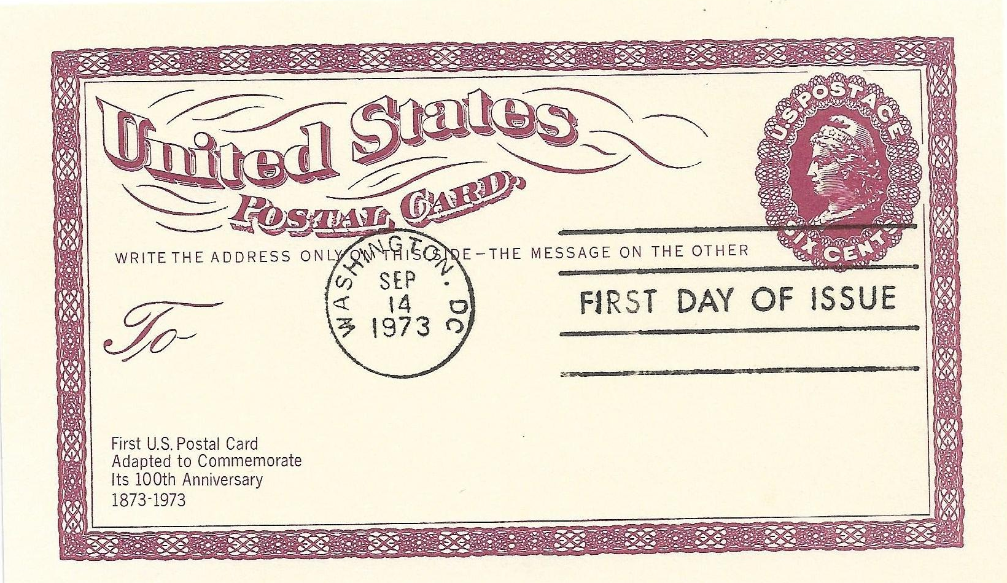
Tag Bar Missing : ERROR

Slide 20
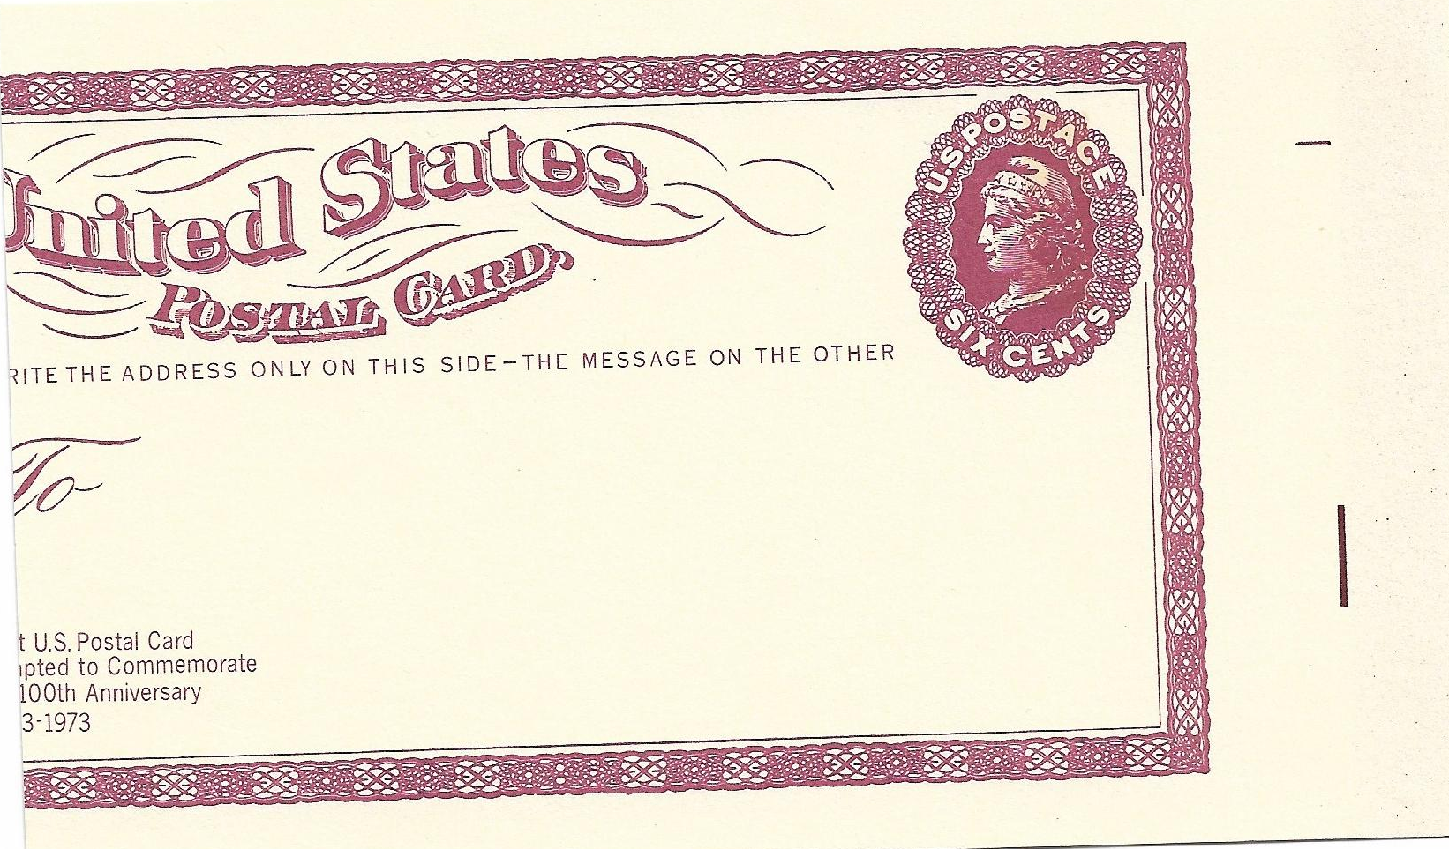
ERROR : Design Shifted Left 20-33mm
Marginal marking on the right.

Slide 21
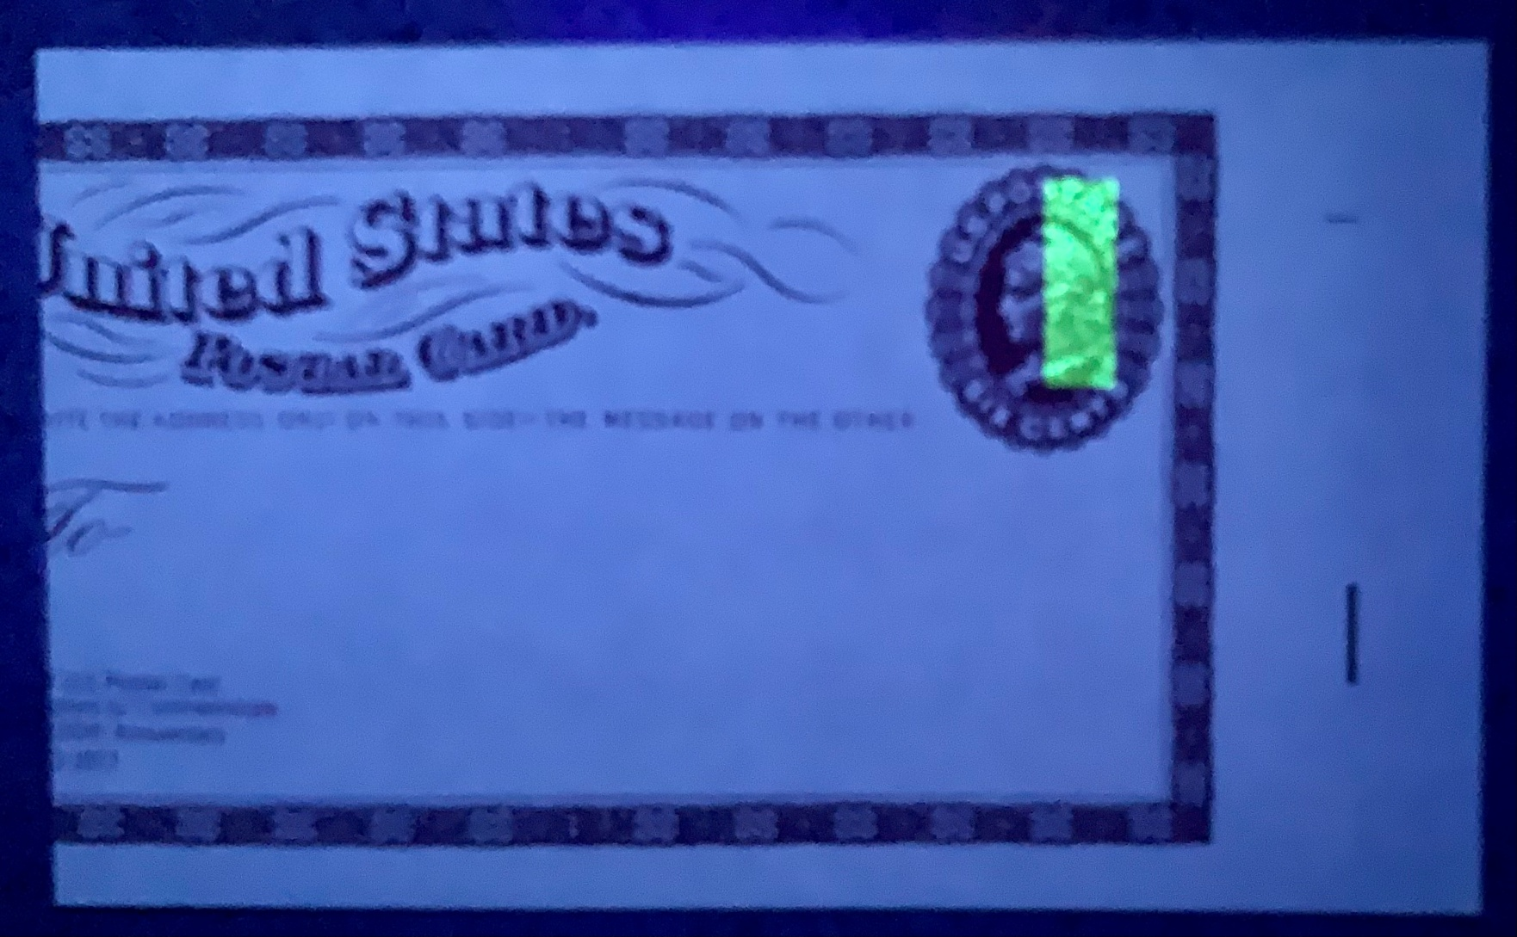
Tag Bar In Normal Position

Slide 22
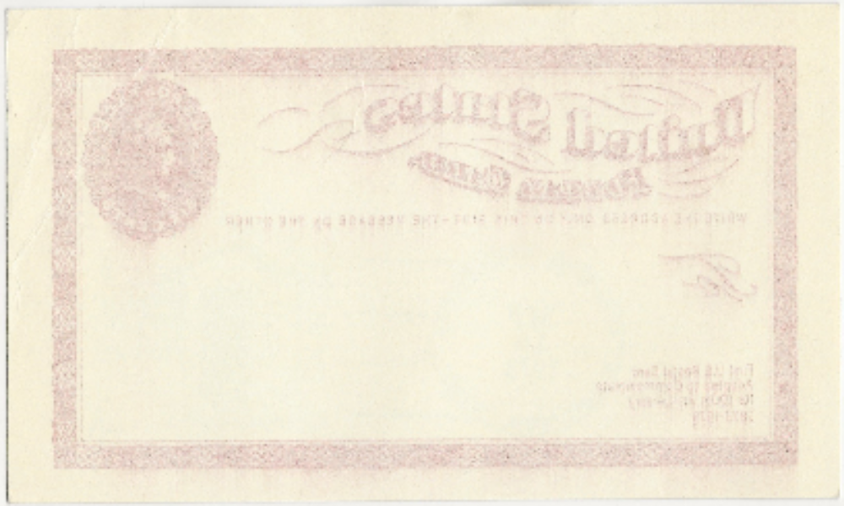
Offset

Slide 23
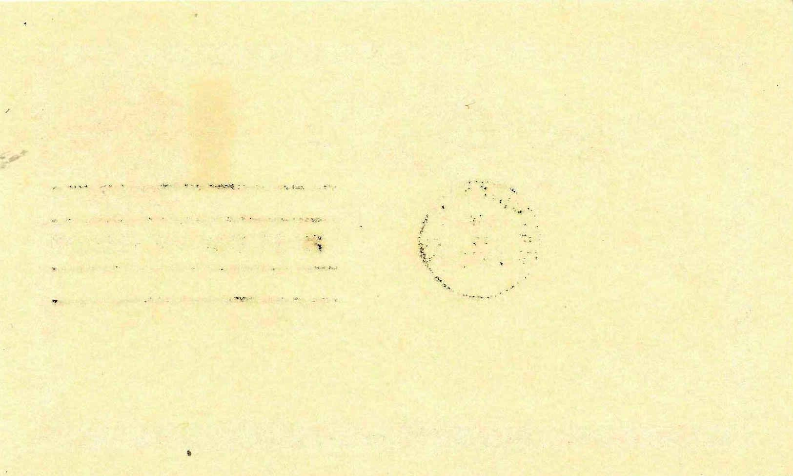
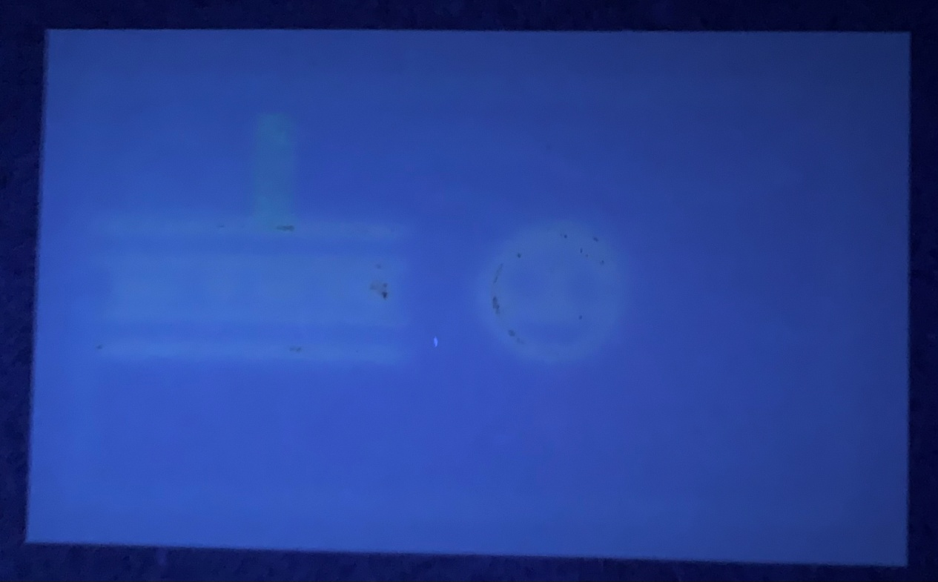
Tag Bar Offset Under UV Light

Slide 24
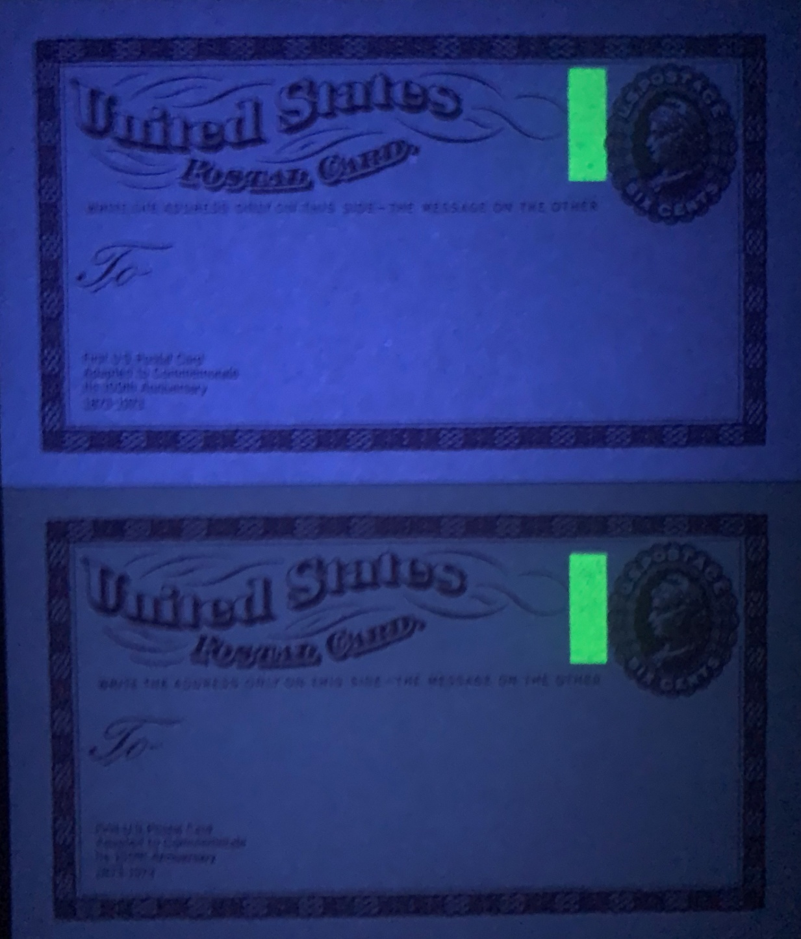
Paper
Fluorescent
Non-fluorescent

Slide 25
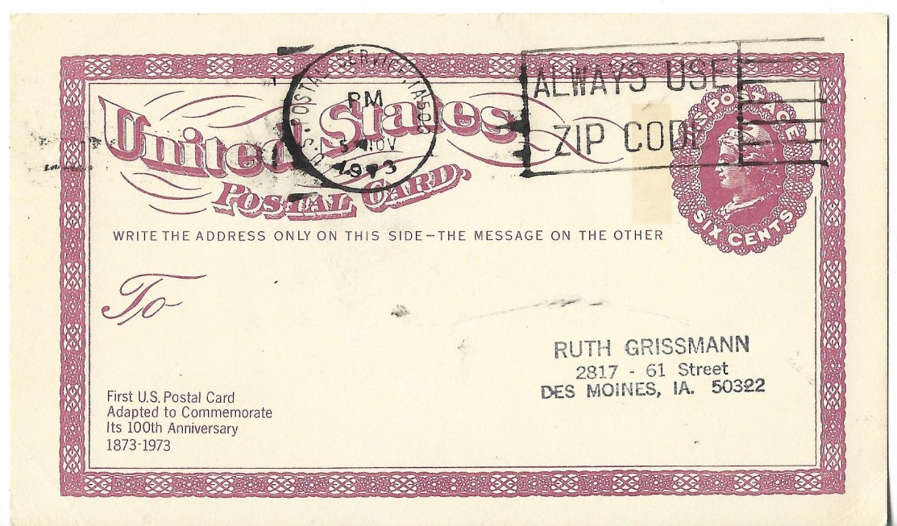
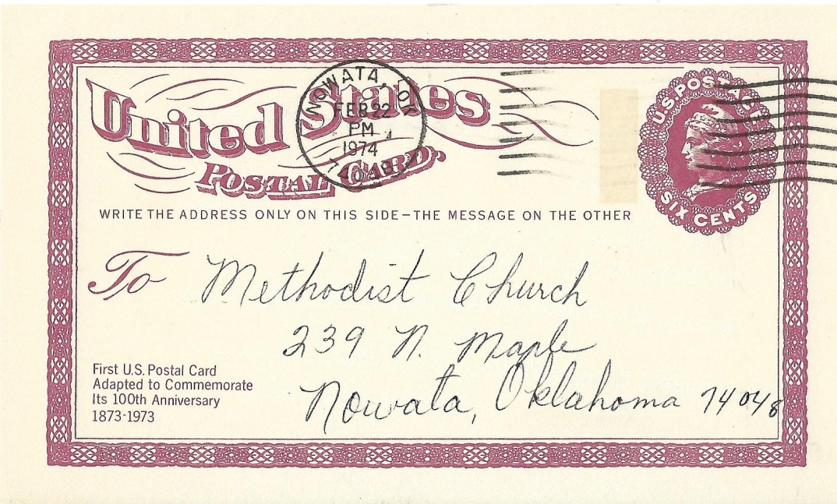
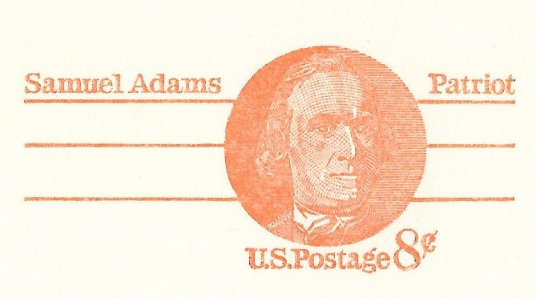
Postal History
Period of Use
Issued during the 6c rate period which was in effect from May 16, 1971 until March 1, 1974.
The Centennial card was in use about seven months. The 8c Samuel Adams of the Patriot series was issued on December 16, 1973 in anticipation of the increase postal card rate to 8c on March 2, 1974.
Ames, IA November 5, 1973
Nowata, OK February 22, 1974

Slide 26
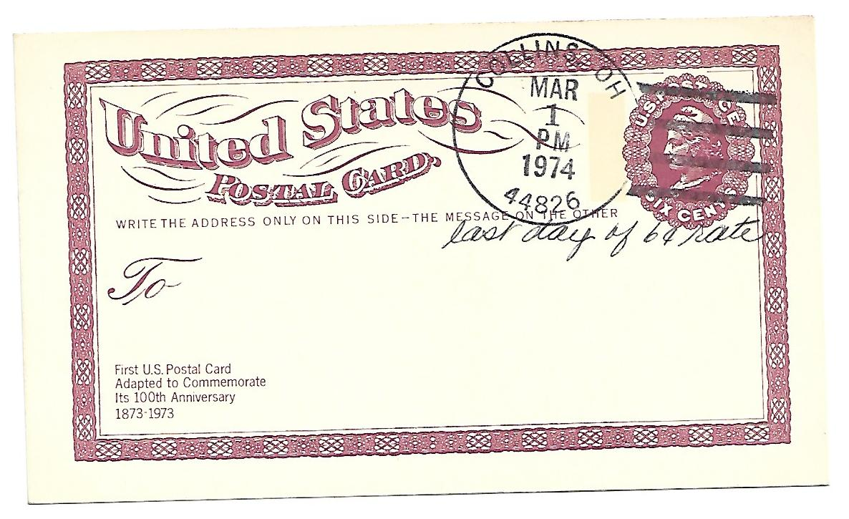
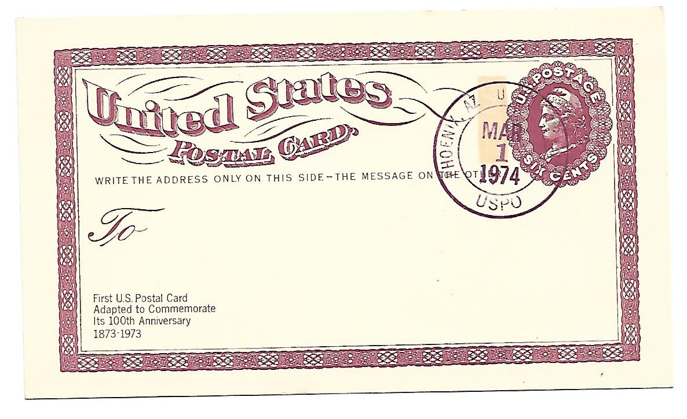
Last Day
6c rate
March 1, 1974
Collins, OH
Phoenix, AZ

Slide 27
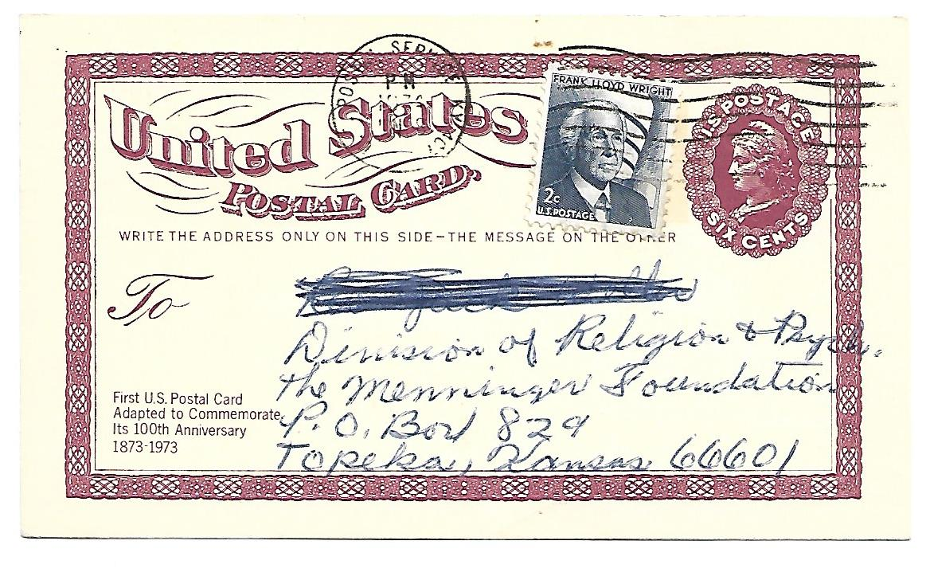
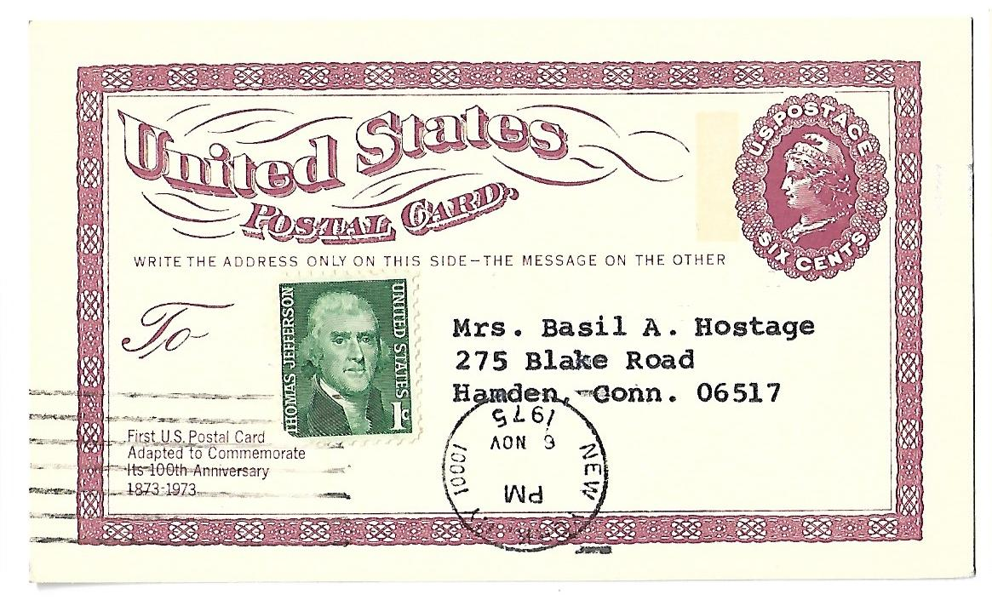
Rate Decrease to 7c
Up Rated to 8c for Rate Change
8c rate effective March 2, 1975 to December 30,1975
Manchester, KY
June 9, 1974.
7c rate effective September 14,1975 to December 30,1975
New York , NY November 6,1975

Slide 28
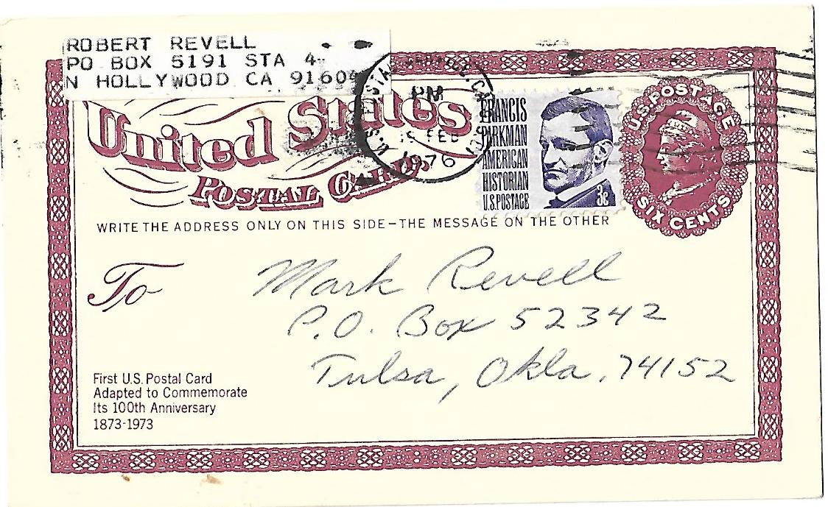
Up Rated to 9c for Rate Change
9c rate effective December 31,1975 to May 28, 1976
N. Hollywood, California February 19, 1976

Slide 29
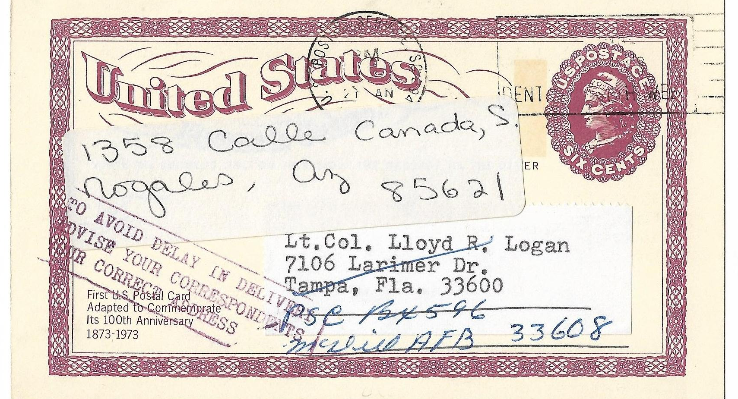
Redirected
Mailed January 21, 1974 from Charleston, SC to Tampa, FL redirected to Mc Dill AFB, FL; redirected again to Nogales, AZ with auxiliary marking : “TO AVOID DELAY IN DELIVERY ADVISE YOUR CORRESPONDENTS YOUR CORRECT ADDRESS.”

Slide 30
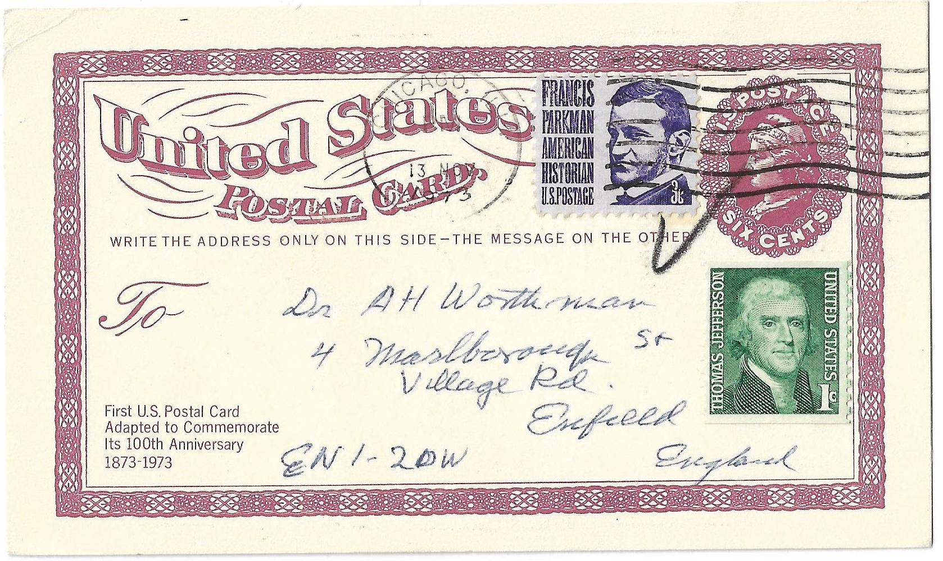
UPU Surface Mail
10c rate effective July 1, 1971 to March 2, 1974
Chicago, IL to Enfield, England November 13, 1973.

Slide 31
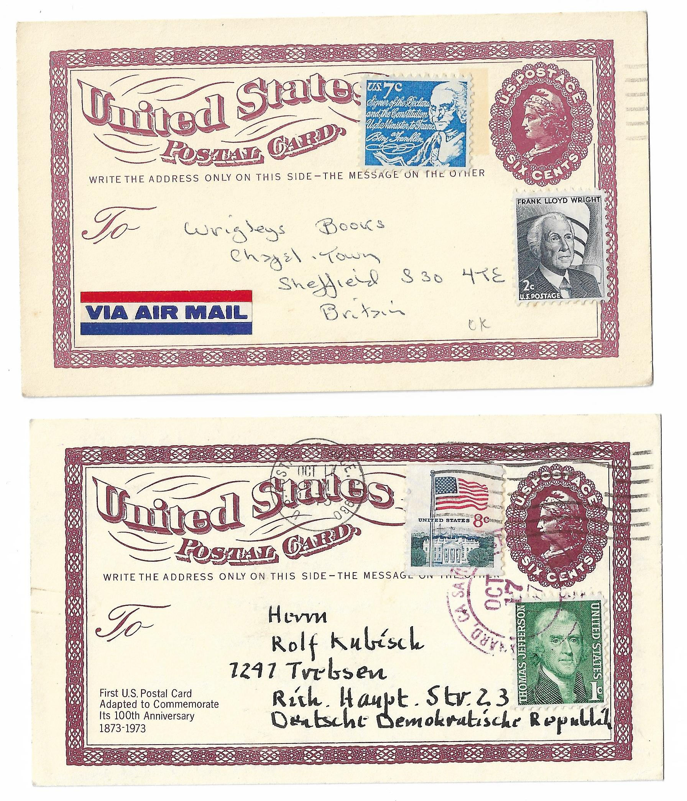
UPU Air Mail
15c rate effective July 1, 1971
to March 2, 1974.
Blairstown, NJ to
Sheffield, England No Date
Postal Service , CA to East Germany October 17, 1973

Slide 32
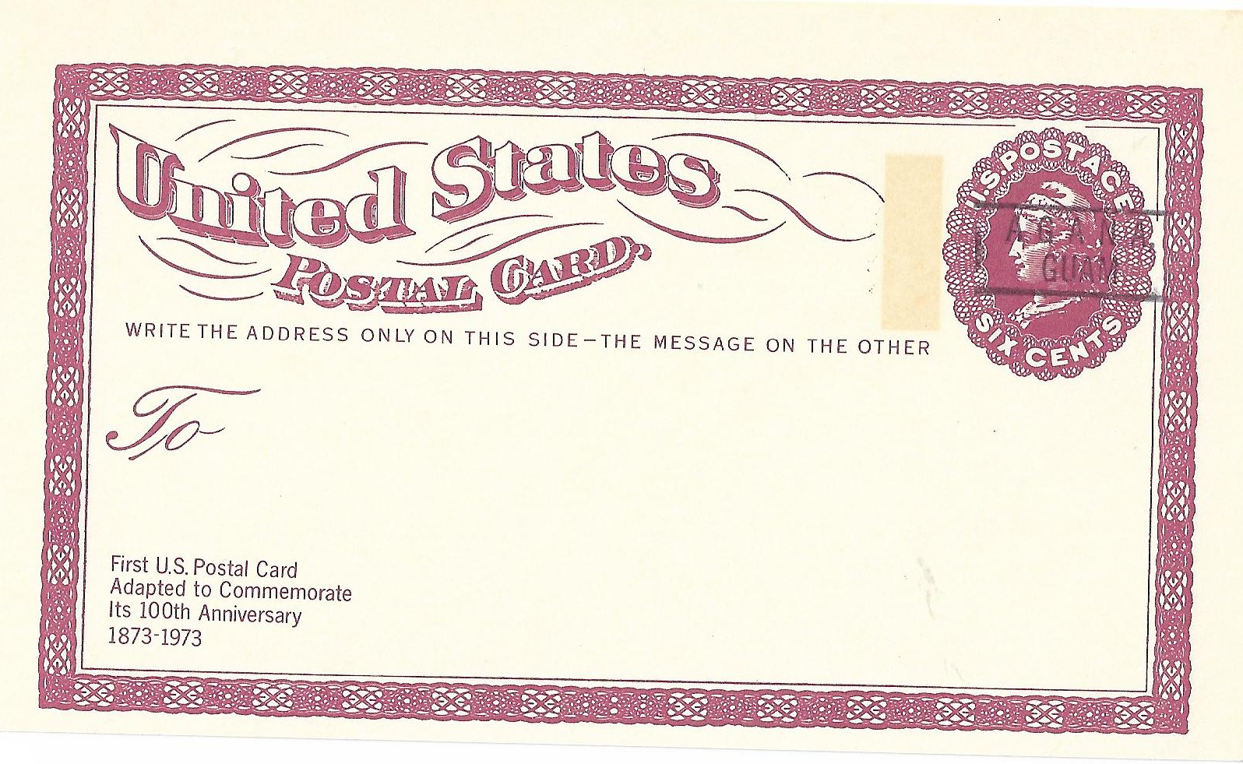
Precancelled
Agana, Guam

Slide 33
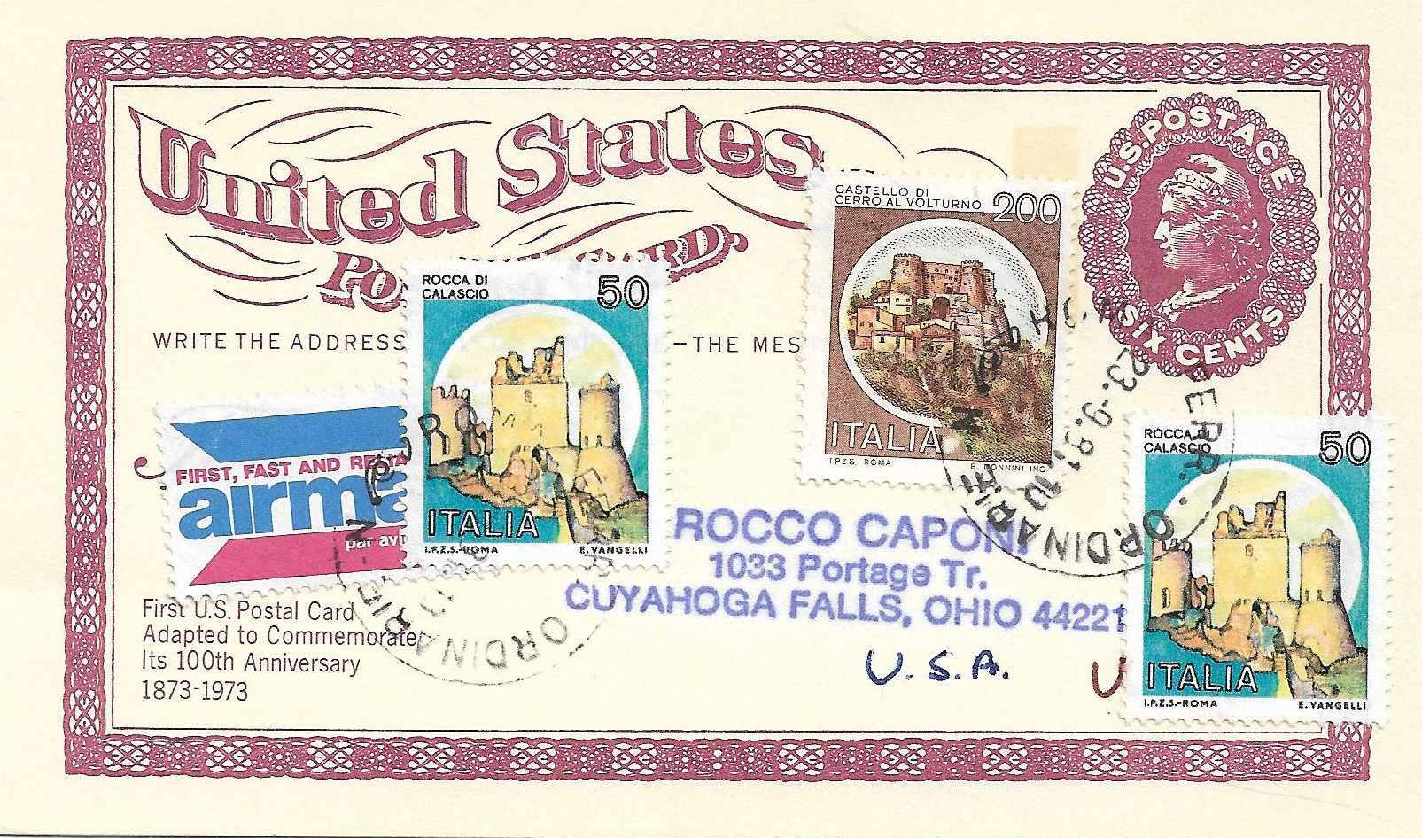
Airmail to the US
Used from Rome, Italy to Ohio in 1981. 300 lire paying the airmail rate to the US. Clearly contrived but colorful.

Slide 34
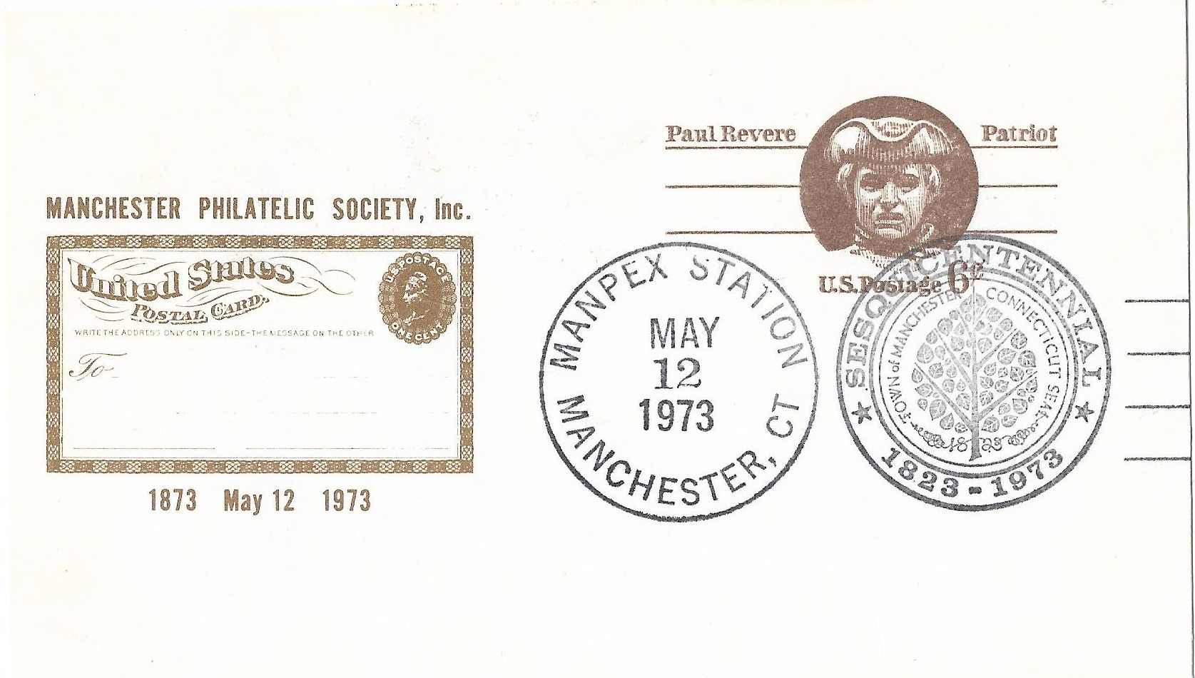
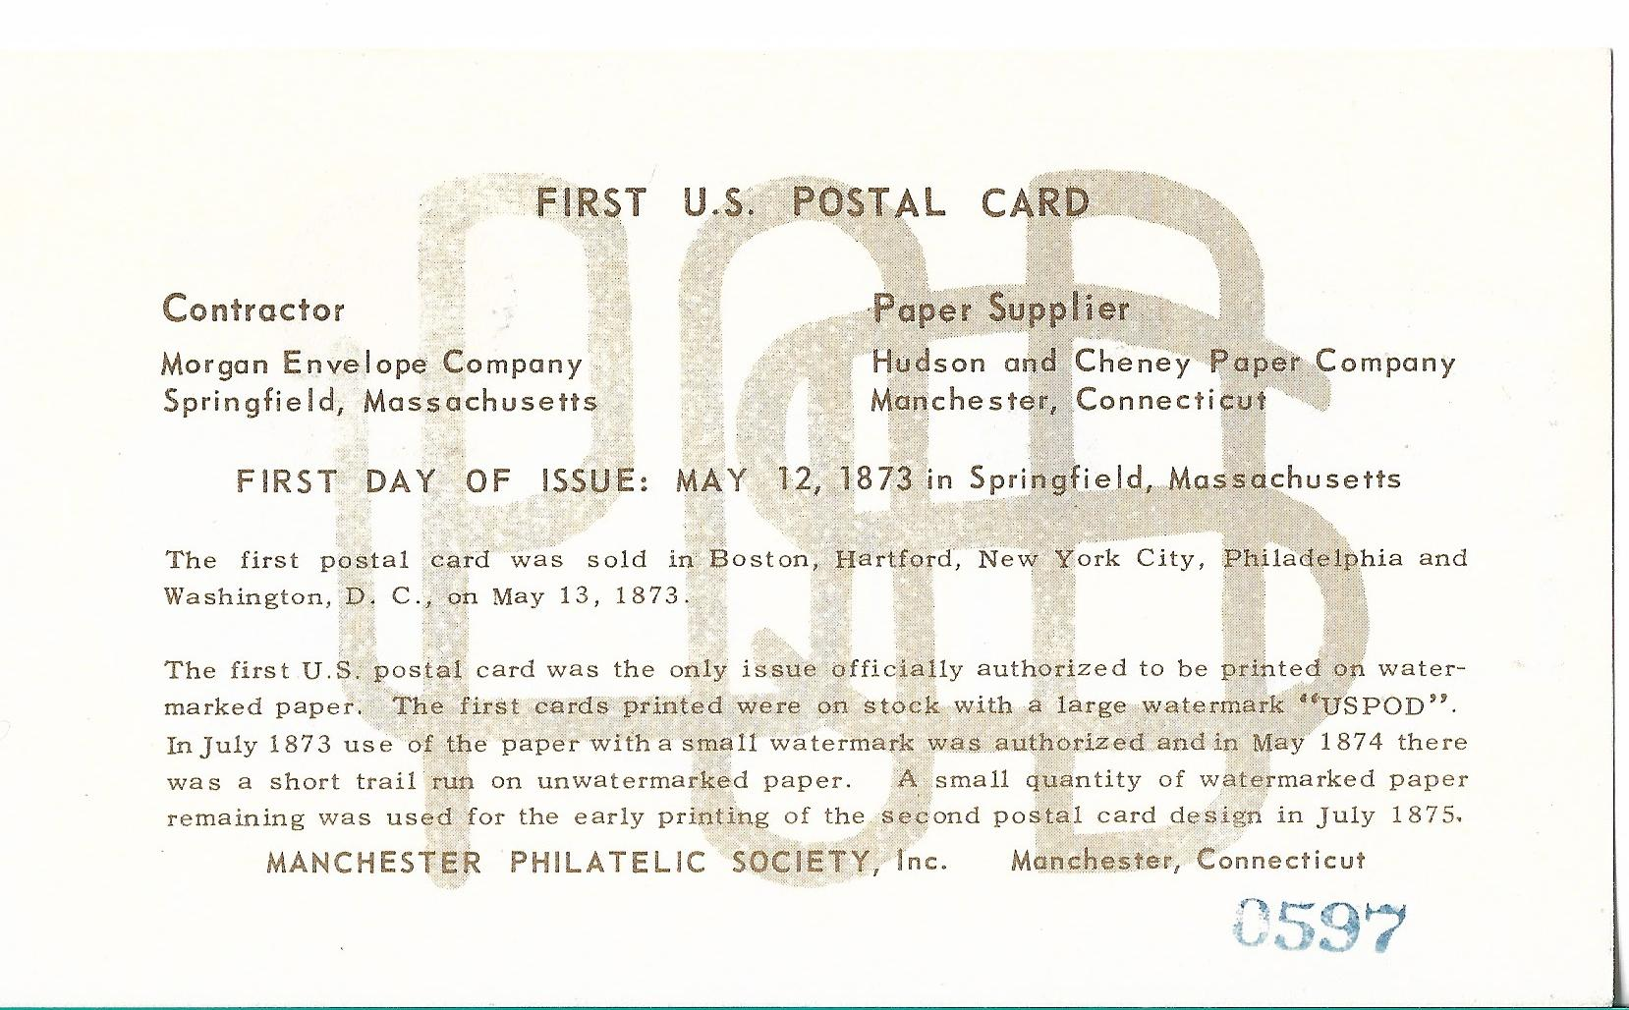
Philatelic Celebrations : MANPEX
Manchester Philatelic Society Manchester, CT
Notes:
Manchester CT home of the paper supplier. Show large watermark that was in the paper stock.

Slide 35

Philatelic Celebrations
Saginaw Valley Stamp Society Saginaw, MI
Notes:
Two Different Color cachet

Slide 36

Philatelic Celebrations: BALLPEX
BALPEX Philatelic Society
Baltimore, MD
Notes:
Different Color cachet for each day a t the show plus Cinderella labels

Slide 37

Philatelic Celebrations : BALLPEX
Notes:
Visiting Postal Administrations

Slide 38

Philatelic
Celebrations
LAPEX Station Laguna Hills, CA
TOSAPEX Wauwatosa, WI
Centenary Unit Pacific Palisades, CA

Slide 39

FDOI
Combo
13c stamp issued to pay the upcoming domestic air letter rate. Effective March 2, 1974. C79
13c cut square issued as a envelope entire for the first class domestic letter rate effective from January 1, 1976 to May 28, 1978.
Centennial Issue of the first commemorative envelope. U219

Slide 40

Rate Change Protest
It took 100 years for the postal card rate to go from 1c to 6c. 1873-1973
It took only 8 years for the rate to go from 6c to 12c. 1973-1981

Slide 41

Peachtree Corners GA
January 27-29, 2023
Celebrating the 150 Anniversary of the first postal card

Slide 42

Southeastern Stamp Expo Show Cancels

Slide 43


